Slide 1





National
Oesophago–Gastric Cancer
Audit
2017 Annual Report

Slide 2
This slide set is designed to
  Summarise the findings from the 2017 Annual Report for presentation at local MDT meetings
  Help you to review your local organisation against other NHS trusts / Local Health Boards in your geographical region and against National figures where appropriate.
We have designed the slides so that you can enter your data from the Annexes of the 2017 Annual Report in the appropriate space.

Slide 3
High Grade Dysplasia (HGD) of the Oesophagus
Since April 2012, the NOGCA has been collecting data on patients with HGD of the oesophagus
The audit aims to monitor current practice against national guidelines
The key BSG recommendations are:
  Diagnosis should be confirmed by a second GI pathologist
  Patients should be discussed at a specialist MDT
  Endoscopic treatment is preferred over surgery or surveillance
    EMRs should be performed in high volume centres
Fitzgerald RC et al. British Society of Gastroenterology guidelines on the diagnosis and management of Barrett's oesophagus. Gut. 2014;63(1):7-42.

Slide 4
National figures for HGD
Details of 1655 cases of HGD seen in English NHS trusts between 1 April 2012 and 31 March 2016
The number of records on HGD cases submitted to the Audit has fallen over time.
Among patients diagnosed between April 2012 and March 2014, the Audit received data on 923 cases
Among patients diagnosed between April 2014 and March 2016, the Audit received data on 732 cases.
Number of patients diagnosed with HGD by English Cancer Alliance,
grouped into two-year periods by date of diagnosis

Slide 5
National figures for HGD
The data items on which patients had their initial diagnosis confirmed by a second pathologist changed from 1 April 2014, and a question was added on the use of quadratic biopsy. In the period since April 2014, 539 patients (85%) had their initial diagnosis confirmed by a second pathologist, while among those who had a second biopsy, 290 patients (88%) had the this result confirmed by a second pathologist. 263 patients (71%) had a quadratic biopsy.
the median length of Barrett’s segments (when reported) was 4 cm (IQR 2-7)
56% of patients were reported to have nodular disease, while 40% had flat mucosa
34% of patients had a multifocal lesion.

Slide 6
Treatment modality for HGD patients
 | 2012-2014 | 2014-2016 | Total
Case discussed at MDT meeting, n(%) | 743 (86.8) | 626 (86.0) | 1369 (86.3)
Treatment modality, n(%)
Endoscopic treatment | 570 (65.3) | 501 (72.8) | 1071 (68.6)
Endoscopic mucosal resection (EMR) | 387 (67.5) | 379 (75.7) | 766 (71.5)
Radiofrequency ablation (RFA) | 139 (24.4) | 96 (19.2) | 235 (21.9)
Endoscopic submucosal dissection (ESD) | 27 ( 4.7) | 21 ( 4.2) | 48 ( 4.5)
Argon Plasma coagulation (APC) | 11 ( 1.9) | 3 ( 0.6) | 14 ( 1.3)
Other | 6 ( 1.1) | 2 ( 0.4) | 8 ( 0.7)
Curative surgical resection | 50 ( 5.7) | 21 ( 3.1) | 71 ( 4.6)
Surveillance or no active treatment | 253 (29.0) | 166 (24.1) | 419 (26.8)

Slide 7
Local treatment plans
Review the number of HGD cases submitted by your organisation
Review the management and treatment plans for HGD patients diagnosed between April 2012- March 2016 in your Cancer Alliance and compare these results with national figures
Annual Report Annex 4

Slide 8
Recommendations for HGD
It is important that NHS Trusts have clear protocols in place to ensure all cases of HGD are referred to the UGI MDT.
Pathologists should use the new SNOMED CT code for Barrett’s oesophagus with high grade dysplasia (“1082761000119106”) to aid identification of these patients
MDT lists should be reviewed on an annual basis to ensure all cases of HGD are reported to the NOGCA. Guidance on which patients to include as HGD cases and which to include as OG cases is available on the NOGCA website (www.nogca.org.uk).
MDTs should prospectively monitor their management of patients with HGD. If they only deal with a few cases of HGD each year, it is important that they consider referral of these cases to their local specialist centre to ensure the patient has all treatment options made available to them.

Slide 9
Oesophago-gastric (OG) Cancer
2017 Annual Report contains results for patients diagnosed from 1st April 2014 to 31st March 2016
Audit prospectively collected data on:
  Patients diagnosed with invasive epithelial OG cancer
  Diagnosed in NHS hospitals in England or Wales
  Aged over 18 at diagnosis

Slide 10
Local OG cancer Data Submissions
Records submitted
 | National | Local Trust
Submission numbers
Cases recorded | 21242 | xx
% case ascertainment | 80% | xx
Complete this slide using data from Annex 5 of 2017 AR
NB Trusts / Local Health Boards who submitted data on less than 10 curative resections are not included in this Annex.
Surgical record completeness for new indicators
Review the quality of data submitted by your organisation using Annex 6 in the 2017 Annual Report
N oesophagectomy N gastrectomy Total cases N pathology records returned N with TNM complete
N with circum margin recorded as N/A Vol complete adeq lymp % complete adeq lymph Vol complete oes long
% complete oes long Vol complete oes circ % complete oes circ Vol complete gast long % complete gast long

Slide 11
Route to diagnosis
Domain | Standard | Indicator
Referral & diagnosis | GPs should be encourage to refer patients as early as possible | % patients diagnosed after an emergency admission
Locally xx% diagnosed after emergency admission
Complete using Annex 7 2017 AR

Slide 12
Patterns of care at diagnosis
Time from diagnosis to first treatment for patients having curative treatments
by Cancer Alliance in England and region in Wales.
NB Cancer Alliances with <10 complete cases are not shown
Overall, around 23% of patients having surgery only as curative treatment waited over 100 days from date of diagnosis to first treatment

Slide 13
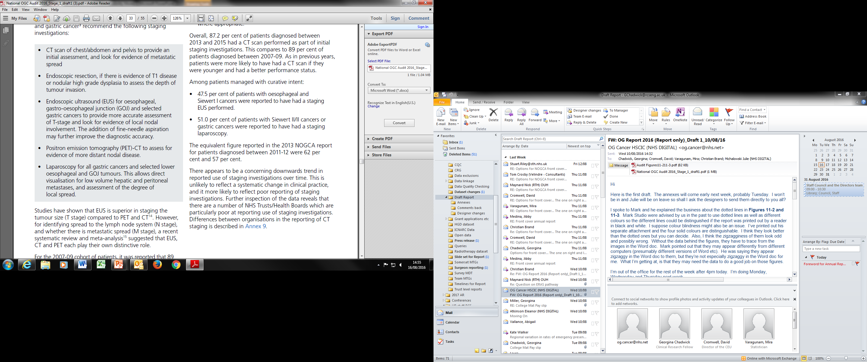
Staging investigations
UK guidelines for staging
Audit Findings show that there is under reporting of staging investigations
Investigation | 2010 Annual Report (First audit) | 2013 Annual Report | 2017 Annual Report
CT scan | 90% | 91.0% | 88.5%
EUS | 58% | 62.0% | 49.4%
Laparoscopy | 48% | 57.0% | 48.3%
Locally XX% had a CT scan
Complete this slide using data from Annex 8 of 2017 AR
NB Organisations who submitted data on less than 10 cases are not included in this Annex.

Slide 14
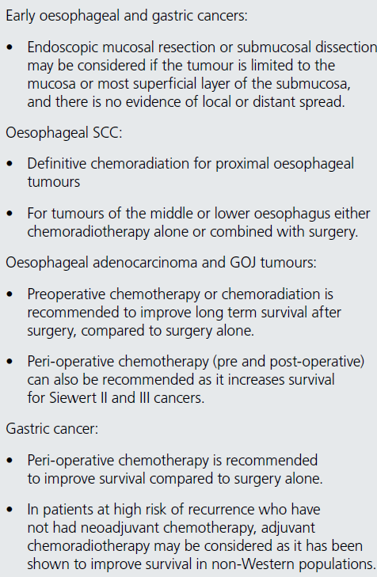
Curative treatment for OG cancer
Overall, 38.7% of patients treated with curative intent
  Variation across regions (may be due to case-ascertainment in some areas)

Slide 15
Survival after definitive chemoradiotherapy and surgery (with/without neoadjuvant therapy) for patients with oesophageal squamous cell carcinoma
Surgery with / without neoadjuvant therapy
Definitive chemoradiotherapy
No. of patients at risk
Stage 0 / 1 124 118 102 70
Stage 2 222 203 155 105
Stage 3 / 4 541 465 331 200
No. of patients at risk
Stage 0 / 1 152 144 134 106
Stage 2 240 218 185 136
Stage 3 / 4 506 433 330 218
No. of patients at risk
Stage 0 / 1 124 118 102 70
Stage 2 222 203 155 105
Stage 3 / 4 541 465 331 200
Outcomes from these population-based Audit data provide some indication of what patients with specific stages of disease might expect from treatment.

Slide 16
Curative surgery
A total of 4,739 curative surgical records were submitted
  2989 Oesophagectomies
  1750 Gastrectomies
Rate of open-shut procedures: 3.7% in 2014-16; 5.0% in 2007-09
Minimally invasive (MI) oesophagectomy: 40.8% in 2014-2016 and 30.0% in 2007-09

Slide 17
Surgical Outcomes
 | Oesophagectomy (%) |  | Gastrectomy (%)
 | 2007-09 | 2014-16 | 2007-09 | 2014-16
30-Day mortality | 3.8 | 1.9 | 4.5 | 1.5
90-Day mortality | 5.7 | 3.3 | 6.9 | 3.1
30 day and 90 day postoperative mortality rates have fallen for both curative oesophagectomy and gastrectomy

Slide 18
Additional indictors for Clinical Outcome Publication (1)
Proportion of patients with 15 or more lymph nodes removed and examined
(both oesophagectomies and gastrectomies)
Locally XX%
Complete this slide using data from Annex 9 of 2017 AR

Slide 19
Additional indictors for Clinical Outcome Publication (2)
Proportion of patients with positive longitudinal margins (oesophagectomies)
Proportion of patients with positive circumferential margins (oesophagectomies)
Proportion of patients with positive longitudinal margins (gastrectomies)
Locally:
XX +long margins OES
XX +circ. margins OES
XX +long margins GAST
Complete this slide using data from Annex 9 of 2017 AR

Slide 20
Additional surgical indictors
These indicators highlight a lack of standardisation in England and Wales in both
the preparation of the surgical specimen after oesophagectomy and gastrectomy, and
the pathological preparation / examination of the surgical specimen.
This lack of standardisation needs to be addressed by the Upper GI surgery and pathology communities.

Slide 21
Local summary of surgery
 | National | Local Trust
% adequate lymph nodes examined (≥15) | 81.4 | xx
Oesophagectomy
Number performed |  | xx
Positive longitudinal margin | 4.1 | xx
Positive circumferential margin | 26.6 | xx
Gastrectomy
Number performed |  | xx
Positive longitudinal margin | 8.0 | xx
Complete this slide using data from Annex 6 and 9 of 2017 AR
NB Trusts who submitted data on less than 10 curative surgical cases are not included in this Annex.

Slide 22
Palliative treatment for OG cancer
Two thirds of patients had non-curative therapies
Choice of palliative modality
  Palliative oncology most common, used in 50.4%
    Lower among older patients with worse performance status
 | Oes SCC |  | Upper/Mid oes ACA |  | Lower oes / Sl ACA |  | GOJ SII / SIII ACA |  | Stomach
 | N | % | N | % | N | % | N | % | N | %
Palliative oncology | 1,366 | 52 | 420 | 48 | 2,240 | 54 | 704 | 56 | 1,623 | 44
Palliative surgery | 95 | 4 | 33 | 4 | 147 | 4 | 29 | 2 | 121 | 3
Endoscopic/radiological palliative therapy | 419 | 16 | 141 | 16 | 552 | 13 | 127 | 10 | 180 | 5
Best supportive care | 756 | 29 | 282 | 32 | 1,192 | 29 | 399 | 32 | 1,774 | 48
Total | 2,636 | 100 | 876 | 100 | 4,131 | 100 | 1,259 | 100 | 3,698 | 100
Missing | 93 |  | 41 |  | 160 |  | 54 |  | 77

Slide 23
Palliative treatment for OG cancer
Choice of palliative modality varied by geographical region of diagnosis

Slide 24
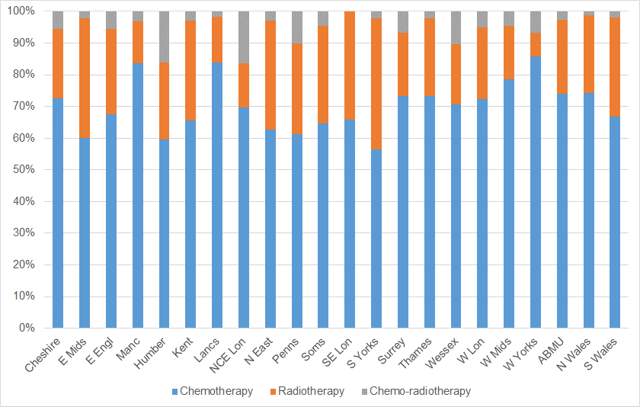
Palliative Oncology
  There was variation in the use of radiotherapy, chemotherapy and chemo-radiotherapy across cancer alliances

Slide 25
Palliative oncology
Most frequently used chemotherapy drugs and combinations (first palliative chemotherapy cycle in SACT) according to tumour site, in England (patients diagnosed April 2014 – March 2016)
Drug or drug combination (%) | Oes SCC | Oes ACA Upper/Mid | Oes ACA Lower/SI | SII/SIII ACA | Stomach | All sites
EOX | 31.4 | 48.5 | 50.3 | 49.2 | 51.2 | 47.1
ECX | 9.8 | 16.7 | 16.5 | 15.9 | 15.2 | 15.0
HCX | 1.2 | 9.9 | 6.6 | 7.1 | 4.9 | 5.5
Capecitabine + cisplatin | 17.1 | 3.0 | 3.4 | 3.1 | 2.1 | 5.3
Capecitabine + oxaliplatin | 4.6 | 2.3 | 4.9 | 4.4 | 7.1 | 5.2
Capecitabine + carboplatin | 4.4 | 5.3 | 2.9 | 2.7 | 4.7 | 3.7
Cisplatin + fluorouracil | 9.5 | 0.0 | 0.8 | 1.0 | 0.6 | 2.2
Ecarbox | 1.0 | 3.8 | 1.8 | 1.0 | 2.2 | 1.8
Carboplatin + etoposide | 5.6 | 1.5 | 0.4 | 1.0 | 0.6 | 1.5
Oxaliplatin + MDG | 1.0 | 0.8 | 1.3 | 1.4 | 1.6 | 1.3
ECF | 1.2 | 0.8 | 1.3 | 1.0 | 1.1 | 1.2
Other combinations | 13.2 | 7.6 | 9.8 | 12.2 | 8.7 | 10.2

Slide 26
Palliative oncology
NOGCA linked to radiotherapy data set (RTDS)
64% of patients followed a regimen recommended by the Royal College of Radiology
59% of patients received the prescribed evidence based dose in the planned number of fractions.
A further 13% of patients followed a commonly used regimen for palliative management (such as a single 8Gy fraction – often used for pain control or to treat bleeding oesophageal lesions)

Slide 27
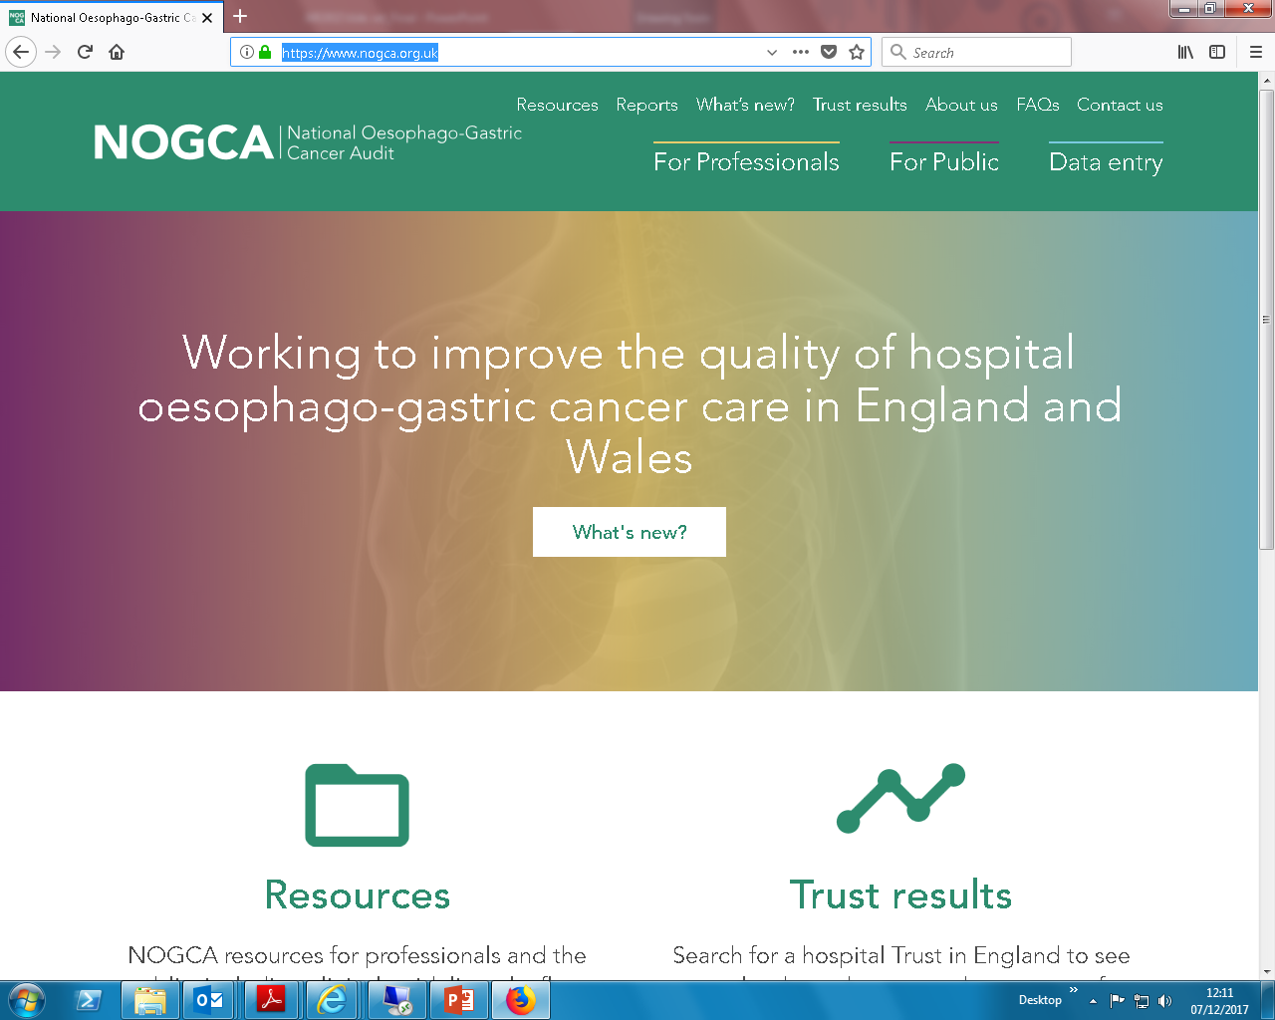
Further details https://www.nogca.org.uk

