Slide 1







National Oesophago-Gastric Cancer Audit
2019 Annual Report: Slide set

Slide 2
This slide set has been created to help NHS organisations:
Present the findings from the NOGCA 2019 Annual Report at local meetings
Review how their services and outcomes compare against other NHS trusts / local health boards and against national figures
Figures from your NHS organisation can be found in the Data Tables for the 2019 Annual Report and added to the slides where indicated.

Slide 3
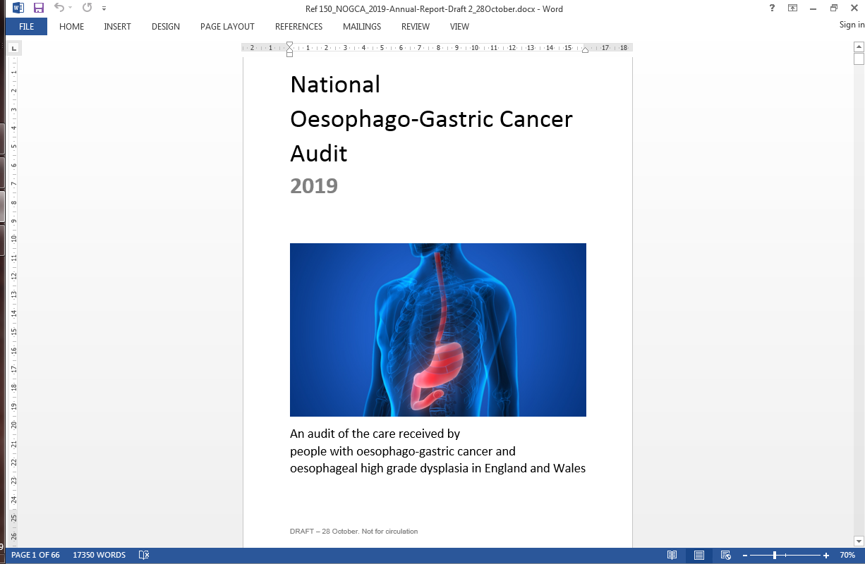
2019 Annual Report covers
Patients diagnosed with oesophago-gastric (OG) cancer in England and Wales
Patients diagnosed with oesophageal high grade dysplasia (HGD) in England

Slide 4
Audit participation
Recommendation | Results on pages
Review cases submitted to the Audit regularly and ensure data collection practices are robust by focusing on (a) case ascertainment in regions where it is currently low, and (b) the completeness of data items, particularly those related to cancer stage. | 12, 19, 28

Slide 5
High grade dysplasia submissions to Audit, by Cancer Alliance
 | Adults of 40+ years in region | Rate per million population Year of diagnosis
Cancer Alliance |  | 2014-16 | 2016-2018
W Yorkshire | 1,212,331 | 28.9 | 9.1
Humber, Coast & Vale | 738,834 | 24.4 | 10.8
Cheshire & Mersey | 1,293,334 | 39.4 | 41.0
S Yorks, Bstlw, N Derb & Hwk | 970,385 | 24.7 | 41.2
W Midlands | 2,899,602 | 20.7 | 16.2
E Midlands | 2,140,600 | 29.9 | 35.0
E England | 3,336,805 | 27.6 | 34.8
SE London | 748,380 | 32.1 | 32.1
Kent & Medway | 946,556 | 44.4 | 38.0
Surrey & Sussex | 1,632,582 | 10.4 | 9.2
Thames Valley | 1,162,553 | 22.4 | 36.1
Peninsula | 990,472 | 35.3 | 25.2
Soms, Wilt, Avon & Glou | 1,474,173 | 24.4 | 38.7
Wessex | 1,386,472 | 49.0 | 36.1
North East & Cumbria | 1,649,549 | 49.1 | 67.9
Lancs & S Cumbria | 890,521 | 30.3 | 34.8
Greater Manchester | 1,311,644 | 41.2 | 14.5
N Cent / NE London | 1,350,660 | 11.1 | 6.7
NW / SW London | 1,557,074 | 19.9 | 17.3

Slide 6
Local OG cancer data submissions
Review the number of OG cancer records submitted by your NHS trust / local health board and compare these results with national figures.
 | England | Wales | Your organisation
Patient records submitted | 20,080 | 1,337 | XX
% case ascertainment | 82.5% | 80.5% | XX
Results for your Alliance are in Sheet 4 of the Data Tables

Slide 7
High grade dysplasia (HGD)
Patient characteristics | Year of diagnosis
 | 2014-16 | 2016-2018
No. of patients | 800 | 797
Median age, years (IQR) | 71 (64-79) | 71 (64-78)
% Male | 78% | 77%
Source of referral
Symptomatic | 51.9% | 49.2%
Surveillance | 48.1% | 50.8%
Comorbidities
Any | 39% | 46%
Cardiovascular | 20% | 22%
COPD | 7% | 11%

Slide 8
Diagnosis of high grade dysplasia
Audit recommendation | Results
Ensure that older patients with suspected high grade dysplasia have their diagnosis confirmed by a second pathologist. | Page 13
 | Patients diagnosed in 2014-18
Indicators (based on BSG guideline) | National | Your Alliance
% patients whose diagnosis was confirmed by 2nd pathologist | 87% | XX
% of patients discussed at the multidisciplinary team (MDT) meeting | 86% | XX
Results for your Alliance are in Sheet 3 of the Data Tables

Slide 9
Pattern of treatment intent for HGD patients, by Cancer Alliance of diagnosis (Apr 2014 - Mar 2018)

Slide 10
Audit recommendations | Results
Ensure that all patients with high grade dysplasia are considered for endoscopic treatment, in line with current recommendations. High rates of non-treatment among patients should be explored in a local audit / review | Page 14
 | Patients diagnosed in 2014-18
Indicator | National | YOUR Alliance
Percentage of patients that had active treatment | 78% | XX
Percentage of patients that had endoscopic treatment | 70% | XX
Results for your Alliance are in Sheet 3 of the Data Tables

Slide 11
Audit recommendations | Results
Ensure protocols are in place with neighbouring hospitals for the referral of all cases of high grade dysplasia to a specialist multi-disciplinary team. | Page 16
Review protocols on the referral of patients to their local specialist centre for endoscopic treatment to ensure annual volumes comply with British Society of Gastroenterology recommended caseloads. | Page 16

Slide 12
% patients having active treatment whose plan was discussed by a specialist MDT, by Alliance of diagnosis (Apr 2014-Mar 2018)

Slide 13
Oesophago-Gastric (OG) cancer
The 2019 Annual Report focuses on patients diagnosed with epithelial OG cancer in England and Wales between April 2016 and March 2018
Records submitted on 21,417 patients in total,
20,080 diagnosed at 132 NHS trusts in England
1,337 diagnosed at 6 local health boards in Wales

Slide 14
Route to diagnosis
Among patients diagnosed with OG cancer in 2016-18, 13% were diagnosed following an emergency admission.
There was substantial variation in emergency diagnoses by Cancer Alliance / Welsh region
Audit recommendations | Results
Investigate reasons for patients being diagnosed with cancer after emergency admission to identify opportunities for improving earlier detection. | Page 22

Slide 15
Route to diagnosis
Route to diagnosis | OES SCC | OES ACA Upper / Mid | OES ACA Lower (w SI,SII) | Stomach (w SIII) | Total
GP referral | 70% | 68% | 69% | 57% | 66%
Urgent / 2 wk wait | 65% | 62% | 63% | 51% | 60%
Routine | 5% | 6% | 6% | 6% | 6%
Emergency adm. | 10% | 11% | 10% | 19% | 13%
Other consultant | 20% | 22% | 21% | 24% | 22%
Total cases | 3,996 | 1,521 | 9,524 | 6,376 | 21,417
Missing values | 50 | 33 | 183 | 121 | 387

Slide 16
Route to diagnosis
Locally, xx% of patients were diagnosed following an emergency admission (Apr 2016 - Mar 2018)
Results for your organisation are in Sheet 6 of the Data Tables
Adjusted rates by region
(Apr 2016 - Mar 2018)

Slide 17
Staging investigations
Audit recommendations | Results
Ensure patients have staging investigations in line with national guidance – notably, all patients being considered for radical treatment have a PET-CT scan, with EUS and staging laparoscopy being used as appropriate. | Pages 25-26

Slide 18
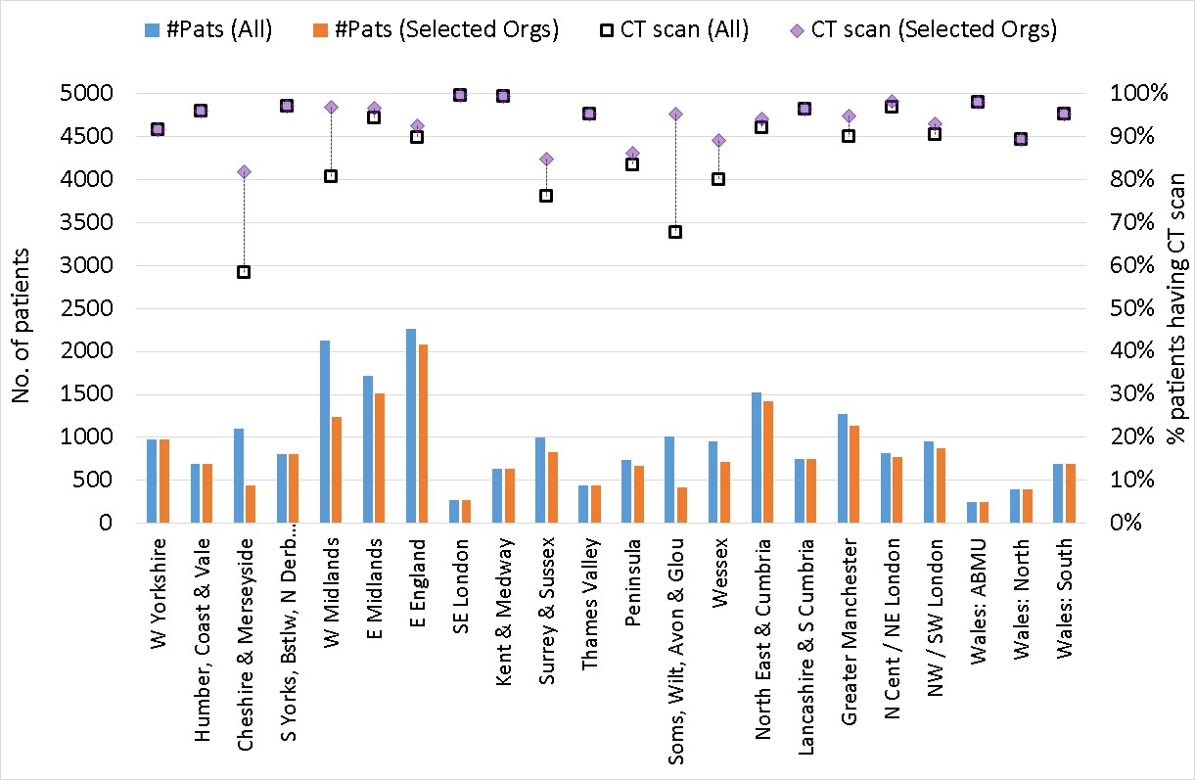
% patients reported as having CT scans (2016-18)
KEY: Purple diamonds show CT scan figures based on organisations with data on investigations for 80% of patients; black squares show CT scan figures based on data from all organisations. Bars show number of patients in each region used to derive the figures.

Slide 19
Staging investigations
Patients are recommended to have a CT scan to identify metastatic disease
NHS organisations varied in the completeness of staging investigations
Locally, xx% of patients had CT scan (Apr 2016 - Mar 2018)
(patients with missing values counted as “not had scan”)
Results for your organisation are in Sheet 6 of the Data Tables

Slide 20
Results for your organisation are in Sheet 6 of the Data Tables
Staging investigations
PET-CT is recommended for all patients with oesophageal cancer being considered for curative treatment. Locally, xx% of patients with OES cancer & had curative treatment had PET-CT (Apr 2016 - Mar 2018)
Use of PET-CT among
patients with OES cancer
and had curative treatment
(2016-2018). Figures based on NHS organisations with good data

Slide 21
Planned curative treatment
Overall, 38% of patients with OG cancer diagnosed in 2016–18 had a curative treatment plan
Clear pattern of curative intent across clinical stage.
Treatment plan | Oes SCC | OES ACA Upper / Mid | OES ACA Lower (w SI,SII) | Stomach (w SIII) | Total
Total patients | 3,996 | 1,521 | 9,524 | 6,376 | 21,417
Curative intent | 39.2% | 31.0% | 41.3% | 33.8% | 37.9%
By clinical stage
0/1 | 65.1% | 61.4% | 77.2% | 67.4% | 71.1%
2 | 60.8% | 56.9% | 63.8% | 59.5% | 61.3%
3 | 47.0% | 41.7% | 59.8% | 45.0% | 52.8%
4 | 7.1% | 4.4% | 5.5% | 3.7% | 5.0%
(missing data) | 653 | 292 | 1394 | 1236 | 3575

Slide 22
Planned curative treatment
Results for your organisation are in Sheet 7 of the Data Tables
Locally, xx% of patients with clinical stage 0-3 had curative treatment plans (Apr 2016 - Mar 2018)

Slide 23
Completeness of data on clinical stage
Locally, xx of yy patients had complete
clinical stage data (Apr 2016 - Mar 2018)
Results for your organisation are in Sheet 7 of the Data Tables

Slide 24
Time from referral to treatment
Among patients diagnosed with OG cancer in 2015-17, 13% were diagnosed following an emergency admission. There was substantial variation in emergency diagnoses by Cancer Alliance / Welsh region
Audit recommendations | Results
Review waiting times through the oesophago-gastric cancer care pathway and identify ways to improve the progression of patients from referral through to diagnosis and treatment | Page 35

Slide 25
Time from referral to start of curative treatment
Locally, median time was xx days (Apr 2016 - Mar 2018)
Results for your organisation are in Sheet 8 of the Data Tables

Slide 26
Time from referral to start of non-curative
oncological treatment
Locally, median time was xx days (Apr 2016 - Mar 2018)
Results for your organisation are in Sheet 8 of the Data Tables

Slide 27
Curative surgery
Among patients diagnosed between April 2015 and March 2018 (3-year period) who had curative surgery, there were:
4,417 oesophagectomies
2,334 gastrectomies
 | Oesophagectomy | Gastrectomy | Overall
30-day mortality (95% CI) | 2.1% (1.7 to 2.6) | 1.5% (1.0 to 1.9) | 1.9% (1.6 to 2.3)
90-day mortality (95% CI) | 3.8% (3.2 to 4.4) | 2.5% (1.9 to 3.2) | 3.4% (3.0 to 3.8)

Slide 28
Postoperative mortality
All NHS organisations achieved similar 30-day and 90-day mortality after curative surgery for patients diagnosed between April 2015 and March 2018
Local 30 day risk-adjusted mortality rate: xx%
Local 90 day risk-adjusted mortality rate: xx%
Results for your organisation are in Sheet 9 of the Data Tables
Adjusted 90-day mortality
after curative surgery for
patients diagnosed between
April 2015 and March 2018

Slide 29
Outcomes after curative surgery
Audit recommendations | Results
Work towards standardising the methods of preparing surgical specimens following resection, particularly in relation to circumferential margins. | Page 41

Slide 30
Pathology outcomes after surgery
Indicator | National average | Your organisation
Proportion of patients with 15 or more lymph nodes examined | 84.4% | XX
Proportion of patients with positive longitudinal margins - oesophagectomy (adjusted) | 3.8% | XX
Proportion of patients with positive circumferential margins - oesophagectomy (adjusted) | 25.4% | XX
Proportion of patients with positive longitudinal margins - gastrectomy (adjusted) | 7.2% | XX
Results for your organisation are in Sheet 9 of the Data Tables

Slide 31
Adjusted rate of positive longitudinal margins All NHS organisations achieved similar rates of longitudinal margins after curative surgery for patients diagnosed between April 2015 and March 2018
oesophagectomy
gastrectomy

Slide 32
Patients receiving non-curative therapies
Distribution of treatments among patients | OES SCC | OES ACA Upper/Mid | OES ACA Lower (w SI,SII) | Stomach (w SIII)
Chemotherapy | 51% | 63% | 71% | 78%
Radiotherapy | 42% | 34% | 27% | 21%
Chemo-radiotherapy | 7% | 3% | 2% | 1%
Outcome of chemotherapy
% Completed | 53.2% | 60.5% | 55.5% | 53.5%
% Patient died | 7.8% | 7.9% | 7.6% | 9.5%
% Progressive disease | 16.5% | 16.4% | 14.8% | 13.5%
% Acute toxicity | 9.2% | 6.2% | 8.9% | 9.5%
% Other | 13.3% | 9.0% | 13.3% | 13.9%
Outcome of radiotherapy
% Completed | 95.4% | 92.6% | 97.2% | 96.5%

Slide 33
Patients receiving non-curative therapies
Audit recommendations | Results
Explore the reasons why patients receiving palliative chemotherapy were unable to complete the regimen, and where appropriate develop plans to address the issues identified. | Page 47
 | Patients treated | Patients with outcome data | % Patients completing therapy
Chemotherapy | XX | XX | XX
Radiotherapy | XX | XX | XX
Results for your organisation are in Sheet 10 of the Data Tables

Slide 34

For further details: www.nogca.org.uk

