Slide 1







National Oesophago-Gastric Cancer Audit
2021 Annual Report: Slide set

Slide 2
This slide set has been created to help NHS organisations:
Present the findings from the NOGCA 2021 Annual Report at local meetings
Review how their services and outcomes compare against other NHS trusts / local health boards and against national figures
Figures from your NHS organisation can be found in the online Data Tables for the 2021 Annual Report and added to the slides where indicated.
Annual Report and Data Tables: www.nogca.org.uk/reports/2021-annual-report/

Slide 3
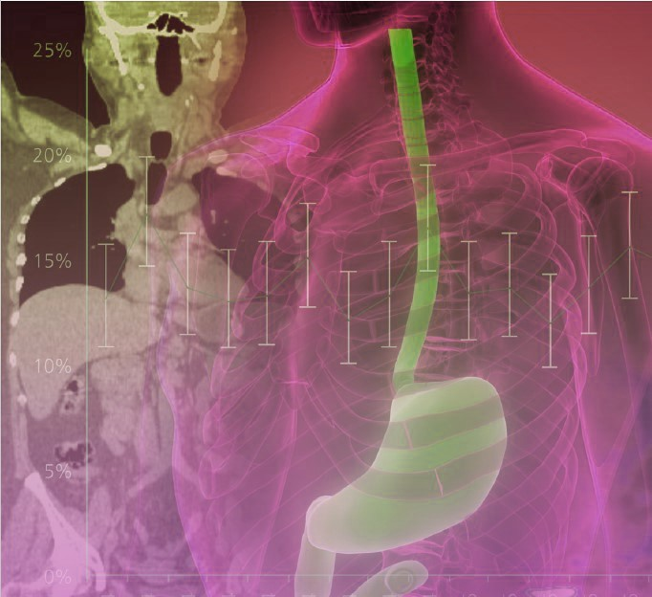
The 2021 Annual Report includes:
Patients diagnosed with oesophago-gastric (OG) cancer in England and Wales
Patients diagnosed with oesophageal high grade dysplasia (HGD) in England

Slide 4
Audit participation
Recommendation | Pages
Review data collection practices for NOGCA and improve (a) case ascertainment in regions where it is currently low, and (b) the completeness of data items, particularly those related to cancer stage. | Pages 13, 18-19

Slide 5
High grade dysplasia submissions to NOGCA per million population, by Cancer Alliance
Cancer Alliance | Adults of 40+ years | HGD cases per million individuals, by year of diagnosis
 |  | 2014 - 2016 | 2016 - 2018 | 2018 - 2020
Cheshire and Merseyside | 1,306,576 | 34 | 38 | 8
East Midlands | 2,399,417 | 25 | 58 | 38
East of England - North | 1,565,584 | 34 | 60 | 49
East of England - South | 1,828,393 | 18 | 31 | 38
Greater Manchester | 1,326,035 | 36 | 14 | 5
Humber, Coast and Vale | 933,312 | 20 | 8 | 8
Kent and Medway | 963,913 | 41 | 31 | 18
Lancashire and South Cumbria | 900,424 | 30 | 21 | 20
North Central London | 633,983 | 11 | 1 | 15
North East London | 773,376 | 6 | 7 | 6
Northern | 1,574,758 | 46 | 80 | 67
Peninsula | 1,008,586 | 33 | 18 | 11
RM Partners West London | 1,614,277 | 17 | 18 | 19
Somerset, Wiltshire, Avon and Gloucestershire | 1,610,384 | 19 | 47 | 58
South East London | 771,084 | 27 | 19 | 8
South Yorkshire and Bassetlaw | 754,788 | 28 | 27 | 15
Surrey and Sussex | 1,865,518 | 9 | 11 | 8
Thames Valley | 870,431 | 22 | 24 | 16
Wessex | 1,406,441 | 43 | 37 | 18
West Midlands | 2,934,042 | 19 | 32 | 29
West Yorkshire and Harrogate | 1,132,450 | 24 | 5 | 8

Slide 6
OG cancer data submissions
Review the number of OG cancer records submitted by your NHS trust / local health board and compare these with national figures
Patients diagnosed with OG cancer, 1 April 2018 – 31 March 2020 | England | Wales | Your organisation
Patient records submitted | 19,002 | 1,317 | XX
% case ascertainment | XX% | XX% | XX
Results for your organisation are in Sheet 4 of the Data Tables
Note: Case ascertainment estimates for Wales will be slightly too low because it is not possible to identify and remove patients with non-epithelial cancers in PEDW. Please see page 18 of the Annual Report for further details.

Slide 7
High grade dysplasia

Slide 8
Diagnosis of high grade dysplasia
Recommendation | Pages
Ensure that older patients with suspected high grade dysplasia have their diagnosis confirmed by a second pathologist. | 14
Indicators (based on BSG guideline) | Patients diagnosed 2016-20
 | National | Your Cancer Alliance
% patients whose diagnosis was confirmed by a 2nd pathologist | 88% | XX
% of patients discussed at the multidisciplinary team (MDT) meeting | 90% | XX
Results for your Alliance are in Sheet 3 of the Data Tables

Slide 9
Initial primary treatment
for patients with HGD,
by Cancer Alliance of diagnosis (2018 - 2020)

Slide 10
Recommendation | Pages
Review whether patients with high grade dysplasia are considered for endoscopic treatment in line with current BSG recommendations, and explore why patients are not being offered endoscopic treatment if there are high rates of non-treatment. | 15-16
Indicators | Patients diagnosed in 2016-20
 | National | Your Cancer Alliance
% of patients who had active treatment | 79% | XX
% of patients who had endoscopic treatment | 72% | XX
Results for your Alliance are in Sheet 3 of the Data Tables

Slide 11
Oesophago-gastric cancer

Slide 12
Routes to diagnosis
Among patients diagnosed with OG cancer in 2018-20, 13% were diagnosed following an emergency admission
There was substantial variation in rates of emergency diagnosis by Cancer Alliance / Welsh region

Slide 13
Routes to diagnosis, by tumour site
Route to diagnosis | Oes SCC | Oes ACA Upper/Mid | Oes ACA Lower (w SI,SII) | Stomach (w SIII) | Total
GP referral | 71% | 64% | 68% | 56% | 65%
Urgent / 2 week wait | 65% | 60% | 63% | 50% | 59%
Routine | 6% | 4% | 5% | 6% | 6%
Emergency admission | 9% | 13% | 10% | 19% | 13%
Other | 20% | 23% | 22% | 25% | 22%
Total cases | 3,878 | 1,599 | 9,231 | 5,611 | 20,319
Missing values | 55 | 27 | 168 | 125 | 375
KEY: Oes – oesophageal, SCC – squamous cell carcinoma, ACA – adenocarcinoma, SI, SII, SIII - Siewert classification of the gastro-oesophageal junction (GOJ).

Slide 14
Routes to diagnosis
Locally, xx% of patients were diagnosed following an emergency admission (Apr 2018 - Mar 2020)
Results for your organisation are in Sheet 6 of the Data Tables
Adjusted rates of diagnosis after emergency admission with 95% confidence intervals, by region. Blue line shows national average (13%).

Slide 15
Staging investigations
It is recommended that all patients with OG cancer have a CT scan to identify metastatic disease
There was substantial variation between NHS organisations in the completeness of information about staging investigations
Locally, xx% of patients had a CT scan (Apr 2018 - Mar 2020)
Results for your organisation are in Sheet 6 of the Data Tables

Slide 16
Staging investigations
Recommendation | Pages
Ensure all patients with oesophageal cancer considered for curative treatment have a PET-CT scan. Hospitals with low reported use of PET-CT scans should investigate the reasons. Use of PET-CT scans for gastric cancer patients should be reviewed in line with recent evidence. | 24-25

Slide 17
Use of PET-CT scans among patients with oesophageal cancer who had curative treatment, by Cancer Alliance / Welsh region
PET-CT is recommended for all patients with oesophageal cancer being considered for curative treatment.
Locally, xx% of patients with oesophageal cancer who had curative treatment had a record of PET-CT (Apr 2018 - Mar 2020)
Results for your organisation are in Sheet 6 of the Data Tables
NOTE: Figures on the use of PET-CT scans were only calculated for NHS organisations that had data on investigations for at least 80% of patients.

Slide 18
Completeness of data on clinical stage
Locally, xx of yy patients had complete clinical stage data
(Apr 2018 - Mar 2020)
Results for your organisation are in Sheet 7 of the Data Tables

Slide 19
Treatment plans
Overall, 39% of patients with OG cancer diagnosed in 2018-20 had a plan for curative treatment
There was substantial variation by clinical stage
Treatment plan | Oes SCC | Oes ACA Upper/Mid | Oes ACA Lower (w SI,SII) | Stomach (w SIII) | Total
Total patients | 3,878 | 1,599 | 9,231 | 5,611 | 20,319
Curative intent | 41.3% | 32.8% | 42.7% | 34.4% | 39.4%
By clinical stage
0/1 | 74.1% | 71.6% | 81.4% | 64.5% | 73.4%
2 | 62.5% | 64.0% | 67.9% | 61.0% | 63.8%
3 | 51.8% | 47.1% | 61.6% | 52.4% | 56.7%
4 | 14.2% | 13.6% | 18.3% | 5.0% | 13.6%
(missing data) | 643 | 362 | 1,414 | 1,226 | 3,645
KEY: Oes – oesophageal, SCC – squamous cell carcinoma, ACA – adenocarcinoma, SI, SII, SIII - Siewert classification of the gastro-oesophageal junction (GOJ) [Siewert et al 1996]. See glossary for details.

Slide 20
Treatment plans
Locally, xx% of patients with clinical stage 0-3 disease had a plan for curative treatment (Apr 2018 - Mar 2020)
The national average was 61%
Results for your organisation are in Sheet 7 of the Data Tables

Slide 21
Waiting times along the care pathway
Among patients diagnosed with OG cancer in 2018-20, the typical waiting time from referral to treatment was over two months for those receiving curative treatments
Overall, 53% of patients diagnosed after an urgent GP referral waited more than 62 days from referral to primary curative treatment, while 20% of patients (all referral routes) waited more than 104 days from referral to primary curative treatment
Among patients having non-curative oncological treatment, 12% waited longer than 104 days from referral to the start of treatment
Recommendation | Pages
Review the oesophago-gastric cancer care pathway and identify ways to improve the time patients take from referral through to diagnosis and treatment, to support implementation of the OG cancer timed diagnostic pathway. | 29-31

Slide 22
Time from referral to start of curative treatment
Locally, median time from referral to start of curative treatment was xx days (Apr 2018 - Mar 2020)
Results for your organisation are in Sheet 8 of the Data Tables

Slide 23
Time from referral to start of non-curative oncological treatment
Locally, median time from referral to start of non-curative oncological treatment was xx days (Apr 2018 - Mar 2020)
Results for your organisation are in Sheet 8 of the Data Tables

Slide 24
Nutritional support in OG cancer
In 2019, the Audit added some items to collect data on nutritional support for patients with OG cancer
Information about dietetic involvement between diagnosis and treatment was submitted for 33% of patients diagnosed between 1 April 2019 and 31 March 2020
Of the patients who had information about nutritional management, 80% received dietetic support:
Dietetic involvement between diagnosis and treatment | Curative treatment plan | Non-curative treatment plan | Total
No. of patients | 3,875 | 6,122 | 9,997
Assessment and advice: general dietitian | 131 ( 9.2%) | 251 (13.1%) | 382 (11.4%)
Assessment and advice: specialist OG dietitian | 937 (65.6%) | 1,036 (54.0%) | 1,973 (58.9%)
Assessment and advice: dietitian (unspecified) | 95 ( 6.7%) | 225 (11.7%) | 320 ( 9.6%)
None: no dietitian available | 36 ( 2.5%) | 38 ( 2.0%) | 74 ( 2.2%)
None: not required | 228 (16.0%) | 370 (19.3%) | 598 (17.9%)
Missing | 2,448 | 4,202 | 6,650

Slide 25
Nutritional support in OG cancer
Recommendation | Pages
Ensure patients are receiving appropriate nutritional support. Hospitals with low levels of data completeness should investigate ways to improve data collection. | 32-24
Locally, information about pre-treatment nutritional support was submitted for xx% of patients (Apr 2019 - Mar 2020).
Of these, xx% received assessment and advice from a dietitian.
Results for your organisation are in Sheet 11 of the Data Tables

Slide 26
Curative surgery
Among patients diagnosed over three years (April 2017 - March 2020) who had curative surgery, there were:
  3,948 oesophagectomies
  2,035 gastrectomies
 | Oesophagectomy | Gastrectomy | Overall
30-day mortality (95%CI) | 1.7% (1.3 to 2.2) | 1.2% (0.7 to 1.7) | 1.6% (1.3 to 1.9)
90-day mortality (95% CI) | 3.6% (3.0 to 4.2) | 2.4% (1.7 to 3.0) | 3.2% (2.7 to 3.6)

Slide 27
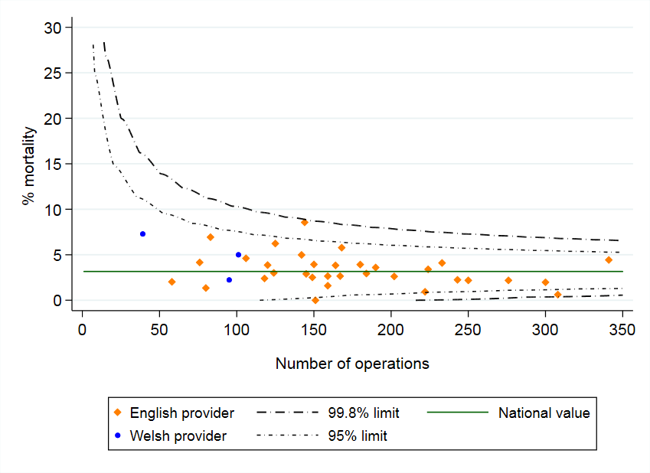
Adjusted 90-day mortality after curative surgery for OG cancer among patients diagnosed April 2017-March 2020 in England and Wales
Local 90-day risk-adjusted mortality rate: xx%
(Local 30-day risk-adjusted mortality rate: xx%)
Results for your organisation are in Sheet 9 of the Data Tables

Slide 28
Pathology outcomes after surgery
Indicator (2017-20) | National average | Your organisation
Proportion of patients with 15 or more lymph nodes examined | 87.9% | XX
Proportion of patients with positive longitudinal margins - oesophagectomy (adjusted) | 4.0% | XX
Proportion of patients with positive circumferential margins - oesophagectomy (adjusted) | 22.0% | XX
Proportion of patients with positive longitudinal margins - gastrectomy (adjusted) | 8.8% | XX
Results for your organisation are in Sheet 9 of the Data Tables

Slide 29
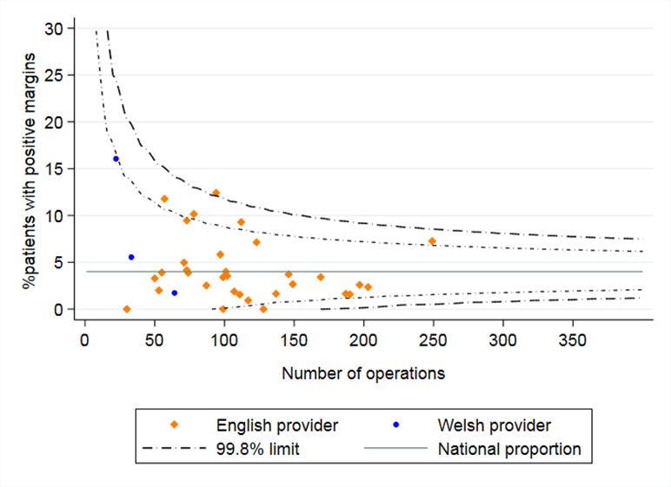
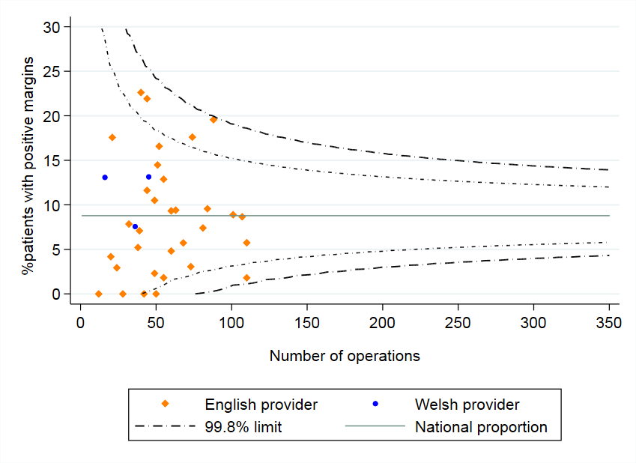
Adjusted rates of positive longitudinal margins
All NHS organisations achieved similar rates of positive longitudinal margins (risk-adjusted) after gastrectomy for patients diagnosed 2017-20. There was one organisation with a higher than expected rate of positive longitudinal margins after oesophagectomy.
Oesophagectomy
Gastrectomy

Slide 30
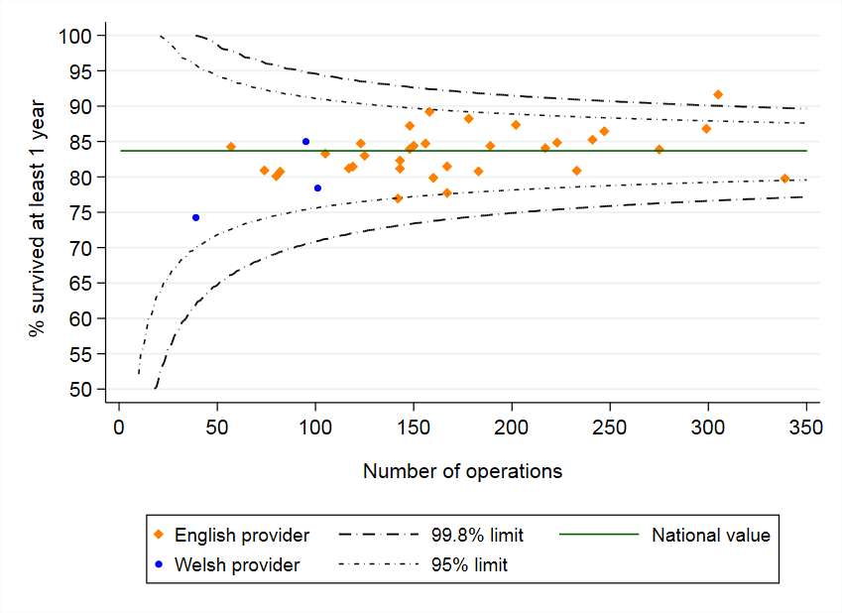
Longer term outcomes after surgery
  For patients diagnosed between 2017-20, the 1-year survival after curative surgery was:
  82.7% among patients with oesophageal cancer and
  85.6% among patients with gastric cancer
Most surgical centres had an adjusted 1-year survival rate that fell within the expected range

Slide 31
Use of perioperative chemotherapy - FLOT
NICE guidelines recommend that patients undergoing curative surgery for stomach cancer should be offered perioperative chemotherapy. Patients with localised oesophageal and GOJ adenocarcinomas (excluding T1N0 tumours) should be offered a choice of perioperative chemotherapy or preoperative chemoradiotherapy.
Clinical trials reported a regimen of FLOT (5-fluorouracil, oxaliplatin and docetaxel) improved survival compared to ECF (epirubicin, cisplatin and 5-fluorouracil), with no increase in surgical complications.
Overall, 41.4% of patients received FLOT among those diagnosed 2017-20 in England who underwent curative resection and chemotherapy for stomach cancer or oesophageal adenocarcinoma.
The use of FLOT has increased from 15.2% among patients diagnosed in 2017/18 to 66.4% among those diagnosed in 2019/20.
There was substantial regional variation in the use of FLOT, ranging from 19% to 78%.

Slide 32
Use of FLOT chemotherapy regimen among patients undergoing curative surgery for OG cancer diagnosed between April 2017 and March 2020, by Cancer Alliance

Slide 33
Use of perioperative chemotherapy - FLOT
Recommendation | Pages
Explore the reasons for the regional variation in the adoption of the FLOT chemotherapy regimen among patients undergoing curative surgery. | 43-44

Slide 34
Non-curative oncological treatment by tumour type
 | Oes SCC | Oes ACA Upper/Mid | Oes ACA Lower (w SI,SII) | Stomach (w SIII) | All
Chemotherapy | 406 (49%) | 225 (70%) | 1,276 (67%) | 773 (78%) | 2,680 (66%)
Radiotherapy | 363 (44%) | 87 (27%) | 565 (30%) | 201 (20%) | 1,216 (30%)
Chemo-radiotherapy | 52 (6%) | 8 (2%) | 49 (3%) | 15 (2%) | 124 (3%)
Immunotherapy | 1 (0.1%) | 1 (0.3%) | 1 (0.1%) | 1 (0.1%) | 4 (0.1%)
Chemotherapy + immunotherapy | 0 | 1 (0.3%) | 5 (0.3%) | 1 (0.1%) | 7 (0.2%)
Outcome of chemotherapy
% Completed | 58.5% | 61.6% | 62.7% | 55.3% | 59.7%
Outcome of radiotherapy
% Completed | 97.8% | 92.2% | 97.8% | 97.0% | 97.3%
KEY: Oes – oesophageal, SCC – squamous cell carcinoma, ACA – adenocarcinoma, SI, SII, SIII - Siewert classification of the gastro-oesophageal junction (GOJ)

Slide 35
Non-curative oncological treatment
Recommendation | Pages
Explore variation in the use of triplet versus doublet regimens for palliative chemotherapy, and the reasons why patients receiving palliative chemotherapy were unable to complete their treatment. Where appropriate, develop plans to address the issues identified. | 46, 51
 | Patients treated | Patients with outcome data | % Patients completing therapy
Chemotherapy | XX | XX | XX
Radiotherapy | XX | XX | XX
Results for your organisation are in Sheet 10 of the Data Tables

Slide 36
Evidence-based (EB) palliative radiotherapy regimens
Most commonly prescribed non-evidence-based palliative radiotherapy regimens among patients diagnosed with OG cancer 2015-2020, by Cancer Alliance
Among patients diagnosed 2015-2020, who had palliative radiotherapy in England, 80.9% had a radiotherapy prescription that corresponded to an RCR-recommended EB regimen for OG cancer
There was substantial regional variation in rates of prescribed EB regimens (range 60% to 97%).
The use of the most commonly prescribed non-EB regimens was concentrated within a few regions.
NOTE: Data omitted for Cancer Alliances with <20 patients receiving non-EB prescriptions

Slide 37
Evidence-based palliative radiotherapy regimens
Recommendation | Pages
Investigate the reasons for low use of evidence-based regimens for palliative radiotherapy and the preference for alternative regimens in some regions | 47-49

Slide 38
For further details: www.nogca.org.uk

