Slide 1







National Oesophago-Gastric Cancer Audit
2022 Annual Report: Slide set

Slide 2
This slide set has been created to help NHS organisations:
Present the findings from the NOGCA 2022 Annual Report at local meetings
Review how their services and outcomes compare against other NHS trusts / local health boards and against national figures
Figures from your NHS organisation can be found in the online Data Tables for the 2022 Annual Report and added to the slides where indicated.
Annual Report and Data Tables: www.nogca.org.uk/reports/2022-annual-report/

Slide 3
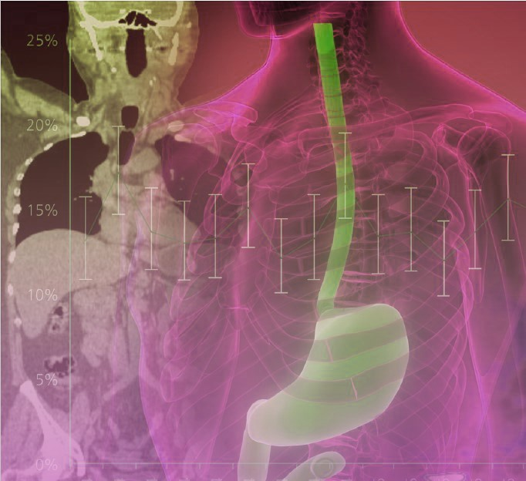
The 2022 Annual Report includes:
Patients diagnosed with oesophago-gastric (OG) cancer in England and Wales
Patients diagnosed with oesophageal high grade dysplasia (HGD) in England

Slide 4
Audit participation
Recommendation | Pages
Review data collection practices for NOGCA and improve case ascertainment in regions where this is low | Pages 11, 47-48

Slide 5
OG cancer data submissions
Review the number of OG cancer records submitted by your NHS trust / local health board and compare these with national figures
Patients diagnosed with OG cancer, 1 April 2019 – 31 March 2021 | England | Wales | Your organisation
Patient records submitted | 17,946 | 1,228 | XX
% case ascertainment | 87.3% | 85.5% | XX
Results for your organisation are in Sheet 4 of the Data Tables
Note: Case ascertainment estimates for Wales will be slightly too low because it is not possible to identify and remove patients with non-epithelial cancers in PEDW. Please see page 11 of the Annual Report for further details.

Slide 6
High grade dysplasia submissions to NOGCA per million population, by Cancer Alliance
Cancer Alliance | Adults of 40+ years | HGD cases per million individuals, by year of diagnosis
 |  | 2015 - 2017 | 2017 - 2019 | 2019 - 2021
Cheshire and Merseyside | 1,311,713 | 40 | 21 | <5
East Midlands | 2,418,182 | 29 | 25 | 17
East of England - North | 1,578,979 | 42 | 46 | 34
East of England - South | 1,845,468 | 17 | 27 | 18
Greater Manchester | 1,333,103 | 28 | 6 | 5
Humber, Coast and Vale | 937,993 | 11 | 14 | 12
Kent and Medway | 971,881 | 46 | 42 | <5
Lancashire and South Cumbria | 904,548 | 30 | 35 | 11
North Central London | 646,619 | 5 | 8 | 40
North East London | 789,625 | 5 | 15 | 5
Northern | 1,582,043 | 52 | 58 | 48
Peninsula | 1,018,959 | 29 | 11 | 18
North West and South West London | 1,640,904 | 17 | 18 | 9
Somerset, Wiltshire, Avon and Gloucestershire | 1,622,911 | 32 | 52 | 24
South East London | 781,539 | 36 | 24 | <5
South Yorkshire and Bassetlaw | 758,199 | 30 | 37 | 29
Surrey and Sussex | 1,881,176 | 9 | 5 | 11
Thames Valley | 879,831 | 26 | 32 | 20
Wessex | 1,416,865 | 42 | 23 | 17
West Midlands | 2,951,262 | 18 | 19 | <5
West Yorkshire and Harrogate | 1,141,107 | 18 | 3 | 9

Slide 7
Oesophago-gastric cancer

Slide 8
Routes to diagnosis
Among patients diagnosed with OG cancer in 2019-21, 12.5% were diagnosed following an emergency admission
There was substantial variation in rates of emergency diagnosis by Cancer Alliance / Welsh region
Recommendation | Pages
Review patients diagnosed after emergency admission and undertake root cause analysis where appropriate to identify opportunities to reduce rates of emergency diagnosis. | 16

Slide 9
Routes to diagnosis, by tumour site
Route to diagnosis | Oes SCC | Oes ACA Upper/Mid | Oes ACA Lower (w SI,SII) | Stomach (w SIII) | Total
GP referral | 70% | 67% | 69% | 56% | 66%
Urgent / 2 week wait | 67% | 64% | 66% | 52% | 62%
Routine | 3% | 3% | 3% | 4% | 4%
Emergency admission | 10% | 11% | 10% | 19% | 12%
Other | 20% | 22% | 21% | 25% | 22%
Total cases | 3,662 | 1,505 | 8,765 | 4,935 | 18,867
Missing values | 55 | 14 | 156 | 82 | 307
KEY: Oes – oesophageal, SCC – squamous cell carcinoma, ACA – adenocarcinoma, SI, SII, SIII - Siewert classification of the gastro-oesophageal junction (GOJ).

Slide 10
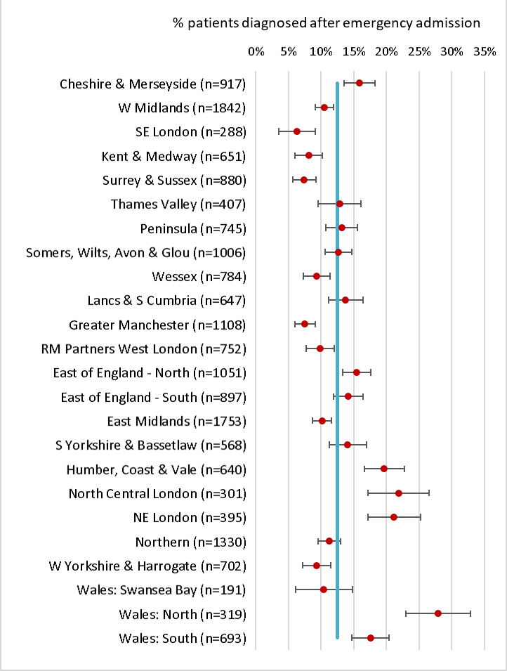
Routes to diagnosis
Locally, xx% of patients were diagnosed following an emergency admission
(Apr 2019 - Mar 2021)
Results for your organisation are in Sheet 6 of the Data Tables
Adjusted rates of diagnosis following an emergency admission with 95% confidence intervals, by Cancer Alliance / Welsh region. Blue line shows national average (12.5%).

Slide 11
Staging investigations
It is recommended that all patients with OG cancer have a CT scan to identify metastatic disease
There was substantial variation between NHS organisations in the completeness of information about staging investigations
Locally, xx% of patients had a CT scan (Apr 2019 - Mar 2021)
Results for your organisation are in Sheet 6 of the Data Tables

Slide 12
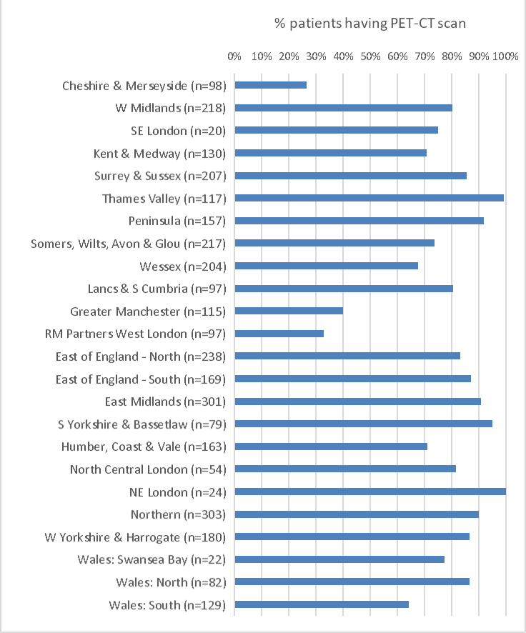
Use of PET-CT scans among patients with oesophageal and gastro-oesophageal junction cancer (except for T1a tumours) who had curative treatment, by Cancer Alliance / Welsh region
PET-CT is recommended for all patients with oesophageal cancer being considered for curative treatment.
Locally, xx% of patients with oesophageal and GOJ cancer who had curative treatment had a record of PET-CT (Apr 2019 - Mar 2021)
Results for your organisation are in Sheet 6 of the Data Tables
NOTE: Figures on the use of PET-CT scans were only calculated for NHS organisations that had data on investigations for at least 80% of patients.

Slide 13
Data on clinical stage
Clinical stage (pre-treatment) | Oes SCC | Oes ACA Upper/Mid | Oes ACA Lower (w SI,SII) | Stomach (w SIII) | Total
Stage 0/1 | 3% | 6% | 5% | 11% | 7%
Stage 2 | 25% | 7% | 9% | 18% | 14%
Stage 3 | 39% | 40% | 40% | 26% | 36%
Stage 4 | 33% | 47% | 46% | 45% | 43%
Missing | 605 | 356 | 1,350 | 1,006 | 3,317
Total | 3,717 | 1,519 | 8,921 | 5,017 | 19,174
Locally, xx of yy patients had complete clinical stage data
(Apr 2019 - Mar 2021)
Results for your organisation are in Sheet 7 of the Data Tables
Recommendation | Page
Review patients diagnosed with stage 4 disease to identify opportunities for earlier detection. | 13

Slide 14
Treatment plans
Overall, 37.5% of patients with OG cancer diagnosed in 2019-21 had a plan for curative treatment
There was substantial variation by clinical stage
Treatment plan | Oes SCC | Oes ACA Upper/Mid | Oes ACA Lower (w SI,SII) | Stomach (w SIII) | Total
Total patients | 3,717 | 1,519 | 8,921 | 5,017 | 19,174
Curative intent | 39.7% | 31.3% | 40.6% | 32.2% | 37.5%
By clinical stage
0/1 | 61.9% | 70.0% | 79.8% | 65.8% | 71.3%
2 | 60.1% | 64.0% | 67.1% | 56.6% | 61.2%
3 | 49.4% | 44.1% | 59.8% | 52.1% | 54.9%
4 | 15.0% | 11.6% | 16.8% | 4.9% | 13.0%
(missing data) | 583 | 340 | 1,296 | 973 | 3,192
KEY: Oes – oesophageal, SCC – squamous cell carcinoma, ACA – adenocarcinoma, SI, SII, SIII - Siewert classification of the gastro-oesophageal junction (GOJ) [Siewert et al 1996]. See glossary for details.

Slide 15
Treatment plans
Locally, xx% of patients with clinical stage 0-3 disease had a plan for curative treatment (Apr 2019 - Mar 2021)
The national average was 58.5%
Results for your organisation are in Sheet 7 of the Data Tables

Slide 16
Waiting times along the care pathway
Overall, 59.5% of patients diagnosed after an urgent GP referral waited more than 62 days from referral to primary treatment, while 20% of patients (all referral routes) waited more than 104 days from referral to primary curative treatment
Among patients having non-curative oncological treatment, 14.5% waited longer than 104 days from referral to the start of treatment
Recommendation | Pages
Review the oesophago-gastric cancer care pathway and identify ways to reduce the proportion of patients waiting more than 104 days from referral to first treatment. | 25-26

Slide 17
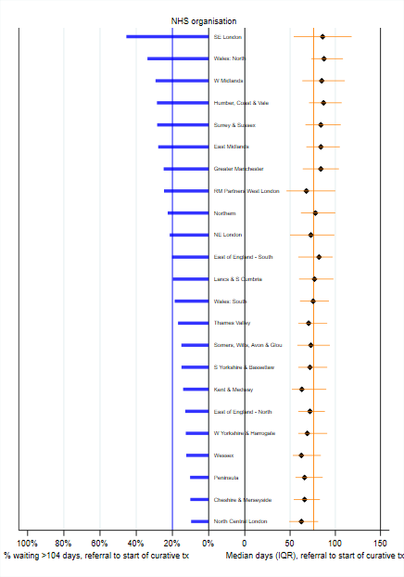
Time from referral to start of curative treatment
Locally, median time from referral to start of curative treatment was xx days (Apr 2019 - Mar 2021)
Results for your organisation are in Sheet 8 of the Data Tables
Median waiting times from referral to start of curative treatment for patients diagnosed between April 2019 and March 2021 and % patients waiting >104 days, by Cancer Alliance / Welsh region

Slide 18
Time from referral to start of non-curative oncological treatment
Locally, median time from referral to start of non-curative oncological treatment was xx days (Apr 2019 - Mar 2021)
Results for your organisation are in Sheet 8 of the Data Tables

Slide 19
Nutritional support in OG cancer
Locally, information about pre-treatment nutritional support was submitted for xx% of patients
(Apr 2019 - Mar 2021).
Of these, xx% received assessment and advice from a dietitian.
Results for your organisation are in Sheet 11 of the Data Tables

Slide 20
Curative surgery
Among patients diagnosed over three years (April 2018 - March 2021) who had curative surgery, there were:
3,632 oesophagectomies
1,770 gastrectomies
 | Oesophagectomy | Gastrectomy | Overall
30-day mortality (95%CI) | 1.5% (1.1 to 1.9) | 1.4% (0.8 to 1.9) | 1.5% (1.2 to 1.8)
90-day mortality (95% CI) | 3.3% (2.7 to 3.9) | 2.6% (1.9 to 3.3) | 3.1% (2.6 to 3.5)

Slide 21
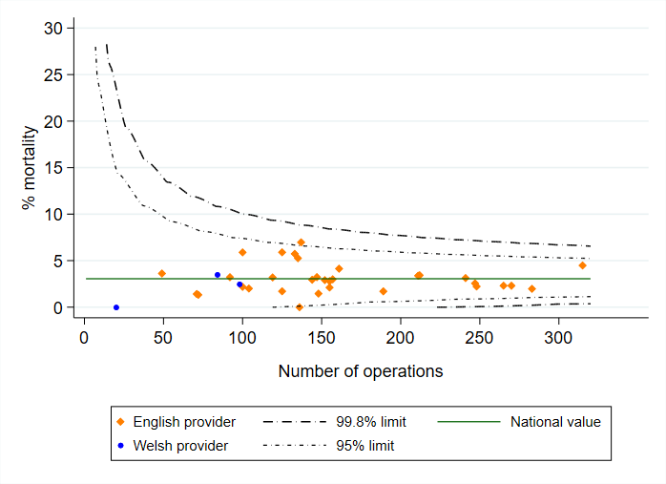
Adjusted 90-day mortality after curative surgery for OG cancer among patients diagnosed April 2018-March 2021 in England and Wales
Local 90-day risk-adjusted mortality rate: xx%
(Local 30-day risk-adjusted mortality rate: xx%)
Results for your organisation are in Sheet 9 of the Data Tables

Slide 22
Pathology outcomes after surgery
Indicator (2018-21) | National average | Your organisation
Proportion of patients with 15 or more lymph nodes examined | 89.3% | XX
Proportion of patients with positive longitudinal margins - oesophagectomy (adjusted) | 4.2% | XX
Proportion of patients with positive circumferential margins - oesophagectomy (adjusted) | 20.3% | XX
Proportion of patients with positive longitudinal margins - gastrectomy (adjusted) | 9.8% | XX
Results for your organisation are in Sheet 9 of the Data Tables

Slide 23
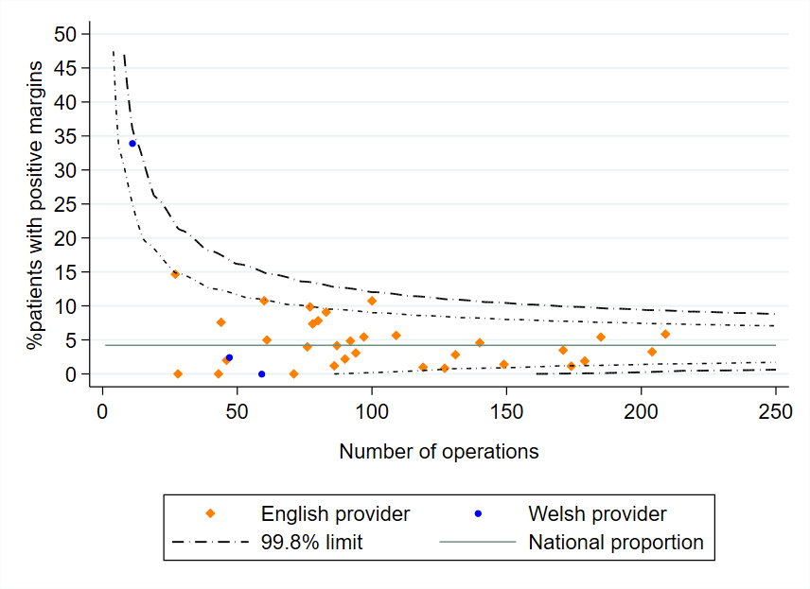
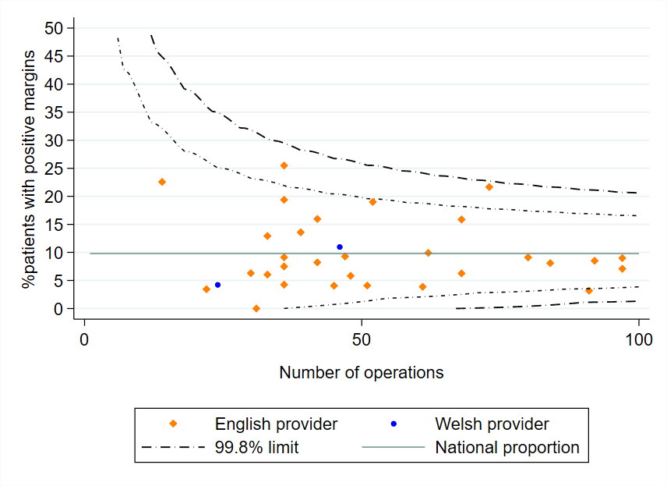
Adjusted rates of positive longitudinal margins
All NHS organisations achieved similar rates of positive longitudinal margins (risk-adjusted) after surgery for patients diagnosed 2018-21.
Oesophagectomy
Gastrectomy

Slide 24
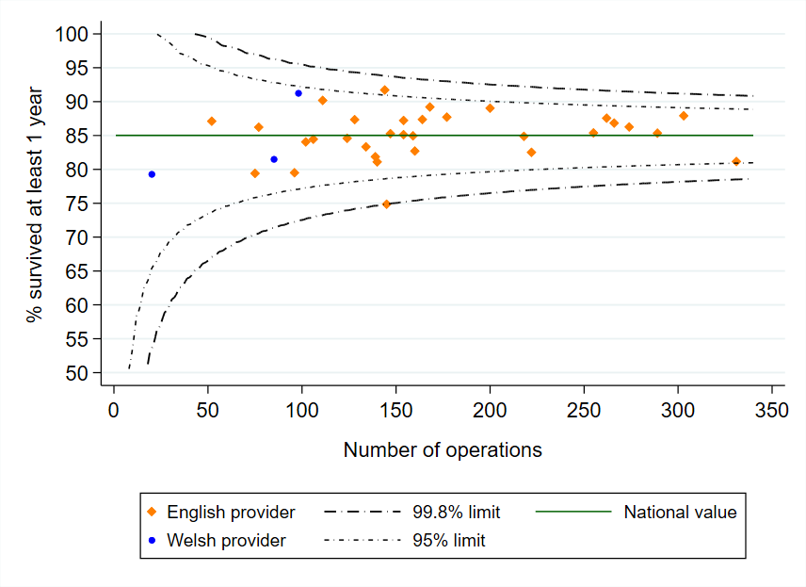
Longer term outcomes after surgery
For patients diagnosed between 2018-21, the 1-year survival after curative surgery was:
83.4% among patients with oesophageal cancer and
85.9% among patients with gastric cancer
All surgical centres had an adjusted 1-year survival rate that fell within the expected range

Slide 25
Use of perioperative chemotherapy - FLOT
NICE guidelines recommend that patients undergoing curative surgery for stomach cancer should be offered perioperative chemotherapy. Patients with localised oesophageal and GOJ adenocarcinomas (excluding T1N0 tumours) should be offered a choice of perioperative chemotherapy or preoperative chemoradiotherapy.
Clinical trials reported a regimen of FLOT (5-fluorouracil, oxaliplatin and docetaxel) improved survival compared to ECF (epirubicin, cisplatin and 5-fluorouracil), with no increase in surgical complications.
Overall, 57.8% of patients received FLOT among those diagnosed 2018-21 in England who underwent curative resection and chemotherapy for stomach cancer or oesophageal adenocarcinoma.
The use of FLOT has increased from 0% among patients diagnosed in 2016/17 to 71.6% among those diagnosed in 2020/21.

Slide 26
Non-curative oncological treatment by tumour type
 | Oes SCC | Oes ACA Upper/Mid | Oes ACA Lower (w SI,SII) | Stomach (w SIII) | All
Chemotherapy | 415 (48%) | 230 (67%) | 1,356 (69%) | 790 (77%) | 2,791 (66%)
Radiotherapy | 381 (45%) | 97 (28%) | 542 (27%) | 214 (21%) | 1,234 (29%)
Chemo-radiotherapy | 60 (7%) | 15 (4%) | 70 (4%) | 17 (2%) | 162 (4%)
Immunotherapy | 1 (0.1%) | 0 | 3 (0.2%) | 3 (0.3%) | 7 (0.2%)
Chemotherapy + immunotherapy | 0 | 1 (0.3%) | 3 (0.2%) | 1 (0.1%) | 5 (0.1%)
Outcome of chemotherapy
% Completed | 56.9% | 65.0% | 63.1% | 58.8% | 61.1%
Outcome of radiotherapy
% Completed | 96.7% | 93.9% | 98.2% | 97.8% | 97.3%
KEY: Oes – oesophageal, SCC – squamous cell carcinoma, ACA – adenocarcinoma, SI, SII, SIII - Siewert classification of the gastro-oesophageal junction (GOJ)

Slide 27
Non-curative oncological treatment
Recommendation | Pages
Explore reasons for non-completion of palliative chemotherapy regimens, and review patient selection for palliative chemotherapy where appropriate. | 40
 | Patients treated | Patients with outcome data | % Patients completing therapy
Chemotherapy | XX | XX | XX
Radiotherapy | XX | XX | XX
Results for your organisation are in Sheet 10 of the Data Tables

Slide 28
Evidence-based (EB) palliative radiotherapy regimens
Most commonly prescribed non-evidence-based palliative radiotherapy regimens among patients diagnosed with OG cancer 2016-2021, by Cancer Alliance
Among patients diagnosed 2016-2021, who had palliative radiotherapy in England, 84.1% had a radiotherapy prescription that corresponded to an RCR-recommended EB regimen for OG cancer
There was substantial regional variation in rates of prescribed EB regimens (range 62.8% to 100%).
The use of the most commonly prescribed non-EB regimens was concentrated within a few regions.
NOTE: Data omitted for Cancer Alliances with <20 patients receiving non-EB prescriptions

Slide 29
Evidence-based palliative radiotherapy regimens
Recommendation | Pages
Investigate the reasons for low use of evidence-based (EB) regimens for palliative radiotherapy and the preference for alternative regimens in some regions. | 42-43

Slide 30
High grade dysplasia

Slide 31
Diagnosis of high grade dysplasia
Indicators (based on BSG guideline) | Patients diagnosed 2017-21
 | National | Your Cancer Alliance
% patients whose diagnosis was confirmed by a 2nd pathologist | 88.7% | XX
% of patients discussed at the multidisciplinary team (MDT) meeting | 91.9% | XX
Results for your Alliance are in Sheet 3 of the Data Tables

Slide 32
Recommendation | Pages
In regions with high rates of surveillance or non-treatment, review whether patients with high grade dysplasia are being considered for endoscopic treatment, in line with current BSG recommendations. | 49-50
Indicators | Patients diagnosed in 2017-21
 | National | Your Cancer Alliance
% of patients who had active treatment | 80.4% | XX
% of patients who had endoscopic treatment | 75.1% | XX
Results for your Alliance are in Sheet 3 of the Data Tables

Slide 33
For further details: www.nogca.org.uk

