Slide 1







National Oesophago-Gastric Cancer Audit
2020 Annual Report: Slide set

Slide 2
This slide set has been created to help NHS organisations:
Present the findings from the NOGCA 2020 Annual Report at local meetings
Review how their services and outcomes compare against other NHS trusts / local health boards and against national figures
Figures from your NHS organisation can be found in the online Data Tables for the 2020 Annual Report and added to the slides where indicated.
Annual Report and Data Tables: www.nogca.org.uk/reports/2020-annual-report

Slide 3
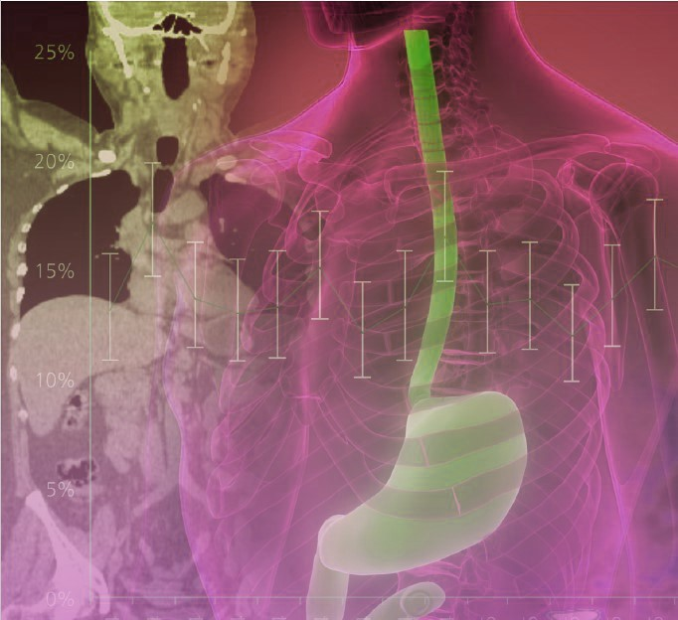
The 2020 Annual Report includes:
Patients diagnosed with oesophago-gastric (OG) cancer in England and Wales
Patients diagnosed with oesophageal high grade dysplasia (HGD) in England

Slide 4
Audit participation
Recommendation | Pages
Regularly review cases submitted to the National Oesophago-Gastric Cancer Audit to ensure (a) high case ascertainment, and (b) low levels of missing data on cancer stage, staging investigations and surgical pathology results. | 13, 18, 26

Slide 5
High grade dysplasia submissions to NOGCA per million population, by Cancer Alliance
Cancer Alliance | Adults aged 40+ years | HGD cases per million, by year of diagnosis
 |  | 2013-2015 | 2015-17 | 2017-2019
Cheshire and Merseyside | 1,389,031 | 37.4 | 37.4 | 19.4
East Midlands | 1,570,650 | 50.9 | 38.8 | 33.7
East of England - North | 3,475,008 | 16.1 | 18.7 | 26.5
East of England - South | 1,488,820 | 29.6 | 20.2 | 21.5
Greater Manchester | 1,441,967 | 16.6 | 9.0 | 16.6
Humber, Coast and Vale | 958,930 | 14.6 | 12.5 | 15.6
Kent and Medway | 990,126 | 11.1 | 14.1 | 3.0
Lancashire and South Cumbria | 936,934 | 17.1 | 29.9 | 33.1
North Central / North East London | 1,562,838 | 34.6 | 3.2 | 9.6
North West and South West London | 1,097,679 | 24.6 | 23.7 | 23.7
Northern | 1,634,735 | 52.6 | 48.9 | 50.2
Peninsula | 1,037,742 | 30.8 | 28.9 | 10.6
Somerset, Wiltshire, Avon and Gloucester | 1,333,184 | 21.8 | 37.5 | 46.5
South East London | 870,132 | 26.4 | 69.0 | 57.5
South Yorkshire and Bassetlaw | 1,178,359 | 24.6 | 22.1 | 25.5
Surrey and Sussex | 1,192,789 | 10.9 | 14.3 | 4.2
Thames Valley | 938,388 | 14.9 | 32.0 | 41.6
Wessex | 1,460,613 | 51.3 | 45.2 | 24.6
West Midlands | 2,615,051 | 15.7 | 18.7 | 17.6
West Yorkshire and Harrogate | 1,217,768 | 23.0 | 18.9 | 14.0

Slide 6
OG cancer data submissions
Review the number of OG cancer records submitted by your NHS trust / local health board and compare these with national figures
Patients diagnosed with OG cancer, 1 April 2017 – 31 March 2019 | England | Wales | Your organisation
Patient records submitted | 19,171 | 1,357 | XX
% case ascertainment | 90.1% | 85.2% | XX
Results for your organisation are in Sheet 4 of the Data Tables
Note: Case ascertainment estimates for Wales will be slightly too low because it is not possible to identify and remove patients with non-epithelial cancers in PEDW. Please see page 18 of the Annual Report for further details.

Slide 7
High grade dysplasia

Slide 8
Diagnosis of high grade dysplasia
Recommendation | Pages
Review patients who do not have their diagnosis of high grade dysplasia (HGD) diagnosed by a second pathologist, and examine the reasons for this to ensure that all patients have their diagnosis confirmed by two pathologists. | 14
Indicators (based on BSG guideline) | Patients diagnosed in 2015-19
 | National | Your Cancer Alliance
% patients whose diagnosis was confirmed by a 2nd pathologist | 87% | XX
% of patients discussed at the multidisciplinary team (MDT) meeting | 88% | XX
Results for your Alliance are in Sheet 3 of the Data Tables

Slide 9
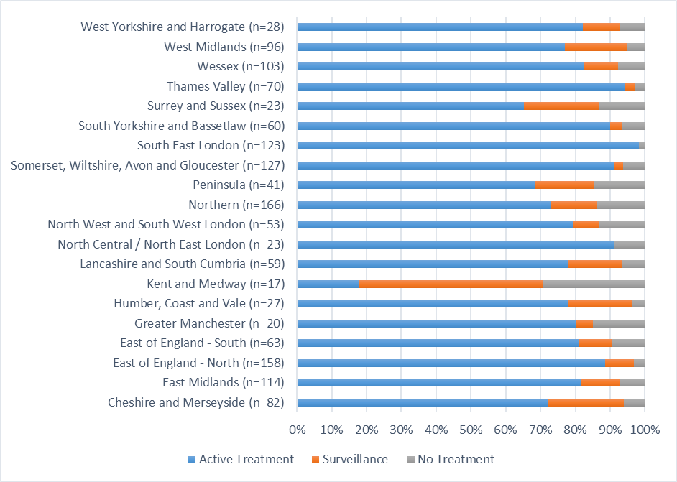
Initial primary treatment for patients with HGD, by Cancer Alliance of diagnosis (2015 - 2019)

Slide 10
Recommendation | Pages
Examine high rates of non-treatment among patients with HGD in a local audit to ensure offers of endoscopic treatment are consistent with British Society of Gastroenterology recommendations. | 15
Indicators | Patients diagnosed in 2015-19
 | National | Your Cancer Alliance
% of patients who had active treatment | 81% | XX
% of patients who had endoscopic treatment | 74% | XX
Results for your Alliance are in Sheet 3 of the Data Tables

Slide 11
Recommendation | Pages
Ensure protocols on the referral of patients to local specialist centres for endoscopic treatment will produce annual volumes at these centres that meet recommended caseloads. | 17

Slide 12
Oesophago-gastric cancer

Slide 13
Routes to diagnosis
Among patients diagnosed with OG cancer in 2017-19, 13% were diagnosed following an emergency admission
There was substantial variation in rates of emergency diagnosis by Cancer Alliance / Welsh region
Recommendation | Pages
Review patients who were diagnosed after emergency admission to identify opportunities for improving earlier detection. | 23

Slide 14
Routes to diagnosis
Route to diagnosis | Oes SCC | Oes ACA Upper/Mid | Oes ACA Lower (w SI,SII) | Stomach (w SIII) | Total
GP referral | 69% | 67% | 67% | 55% | 64%
Urgent / 2 week wait | 64% | 62% | 62% | 49% | 59%
Routine | 5% | 5% | 5% | 6% | 5%
Emergency admission | 10% | 12% | 11% | 19% | 13%
Other | 21% | 22% | 22% | 26% | 23%
Total cases | 3,796 | 1,527 | 9,233 | 5,972 | 20,528
Missing values | 47 | 34 | 154 | 137 | 372
KEY: Oes – oesophageal, SCC – squamous cell carcinoma, ACA – adenocarcinoma, SI, SII, SIII - Siewert classification of the gastro-oesophageal junction (GOJ).

Slide 15
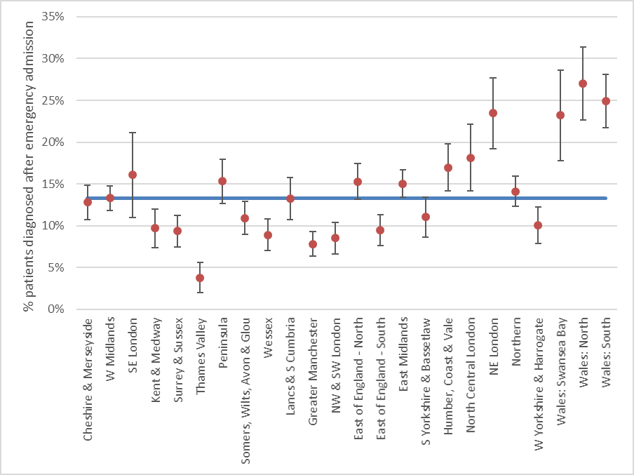
Routes to diagnosis
Locally, xx% of patients were diagnosed following an emergency admission (Apr 2017 - Mar 2019)
Results for your organisation are in Sheet 6 of the Data Tables
Adjusted rates of diagnosis after emergency admission with 95% confidence intervals, by region. Blue line shows national average (13%).

Slide 16
Staging investigations
It is recommended that all patients with OG cancer have a CT scan to identify metastatic disease
There was substantial variation between NHS organisations in the completeness of information about staging investigations
Locally, xx% of patients had a CT scan (Apr 2017 - Mar 2019)
Results for your organisation are in Sheet 6 of the Data Tables

Slide 17
Staging investigations
Recommendation | Pages
Ensure all patients with oesophageal cancer being considered for curative treatment have a PET-CT scan. Hospitals with low reported use of PET-CT scans should investigate to determine the causes. Use of PET-CT scans for gastric cancer patients should be reviewed in line with recent evidence. | 26

Slide 18
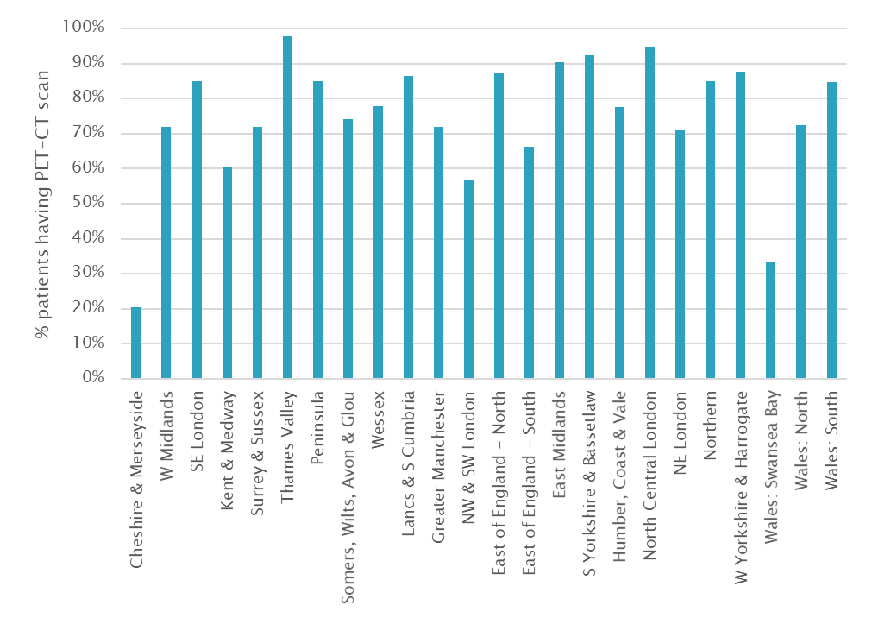
Use of PET-CT scans among patients with oesophageal cancer who had curative treatment, by Cancer Alliance / Welsh region
PET-CT is recommended for all patients with oesophageal cancer being considered for curative treatment.
Locally, xx% of patients with oesophageal cancer who had curative treatment had a record of PET-CT (Apr 2017 - Mar 2019)
Results for your organisation are in Sheet 6 of the Data Tables
NOTE: Figures on the use of PET-CT scans were only calculated for NHS organisations that had data on investigations for at least 80% of patients.

Slide 19
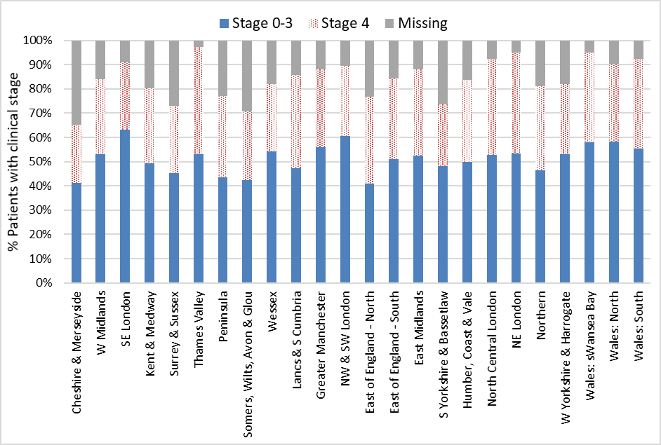
Completeness of data on clinical stage
Locally, xx of yy patients had complete clinical stage data
(Apr 2017 - Mar 2019)
Results for your organisation are in Sheet 7 of the Data Tables

Slide 20
Treatment plans
Overall, 39% of patients with OG cancer diagnosed in 2017-19 had a plan for curative treatment
There was substantial variation by clinical stage
Treatment plan | Oes SCC | Oes ACA Upper/Mid | Oes ACA Lower (w SI,SII) | Stomach (w SIII) | Total
Total patients | 3,796 | 1,527 | 9,233 | 5,972 | 20,528
Curative intent | 40.4% | 32.0% | 41.8% | 33.9% | 38.5%
By clinical stage
0/1 | 72.9% | 69.0% | 78.9% | 64.6% | 72.3%
2 | 62.8% | 56.4% | 64.2% | 61.4% | 62.5%
3 | 48.6% | 44.9% | 61.6% | 50.6% | 55.4%
4 | 10.9% | 10.4% | 12.5% | 4.1% | 9.5%
(missing data) | 614 | 317 | 1,362 | 1,272 | 3,565
KEY: Oes – oesophageal, SCC – squamous cell carcinoma, ACA – adenocarcinoma, SI, SII, SIII - Siewert classification of the gastro-oesophageal junction (GOJ) [Siewert et al 1996]. See glossary for details.

Slide 21
Treatment plans
Locally, xx% of patients with clinical stage 0-3 disease had a plan for curative treatment (Apr 2017 - Mar 2019)
The national average was 60%
Results for your organisation are in Sheet 7 of the Data Tables

Slide 22
Waiting times along the care pathway
Among patients diagnosed with OG cancer in 2017-19, the typical waiting time from referral to treatment was over two months for those receiving curative treatments
Overall, 60% of patients waited more than 62 days from referral to primary curative treatment, while 19% of patients waited more than 104 days
Among patients having non-curative oncological treatment, 42% waited longer than 62 days from referral to the start of treatment and 12% waited longer than 104 days
Recommendation | Pages
Review waiting times through the oesophago-gastric cancer care pathway and identify ways to reduce the proportion of patients waiting longer than 62 days from referral to treatment. | 32-33

Slide 23
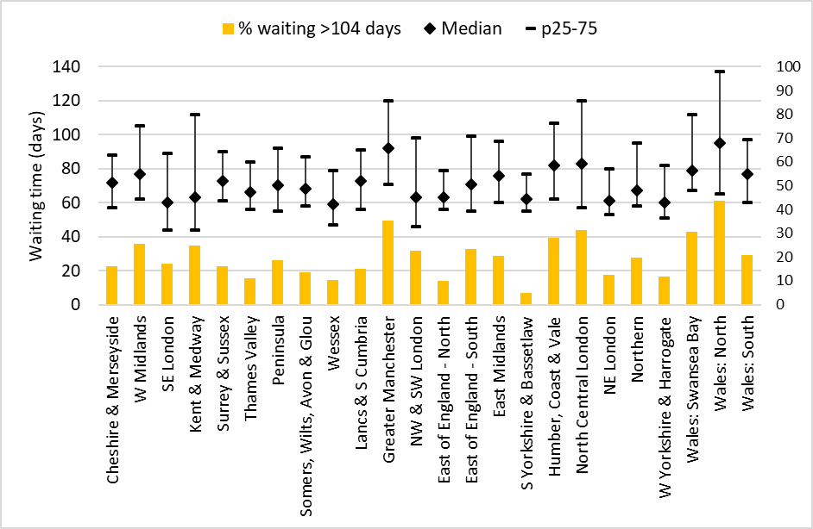
Time from referral to start of curative treatment
Locally, median time from referral to start of curative treatment was xx days (Apr 2017 - Mar 2019)
Results for your organisation are in Sheet 8 of the Data Tables

Slide 24
Time from referral to start of non-curative oncological treatment
Locally, median time from referral to start of non-curative oncological treatment was xx days (Apr 2017 - Mar 2019)
Results for your organisation are in Sheet 8 of the Data Tables

Slide 25
Curative surgery
Among patients diagnosed over three years (April 2016 - March 2019) who had curative surgery, there were:
  4,112 oesophagectomies
  2,163 gastrectomies
 | Oesophagectomy | Gastrectomy | Overall
30-day mortality (95%CI) | 2.0% (1.6 to 2.4) | 1.2% (0.7 to 1.7) | 1.7% (1.4 to 2.1)
90-day mortality (95% CI) | 3.7% (3.1 to 4.3) | 2.5% (1.8 to 3.1) | 3.3% (2.8 to 3.7)

Slide 26
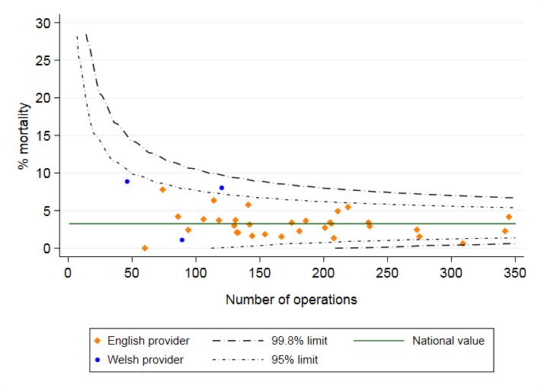
Postoperative mortality
Local 30-day risk-adjusted mortality rate: xx%
Local 90-day risk-adjusted mortality rate: xx%
Results for your organisation are in Sheet 9 of the Data Tables

Slide 27
Enhanced recovery after surgery (ERAS)
The use of ERAS protocols was clustered within NHS trusts, with 29 out of 35 English surgical centres adopting this approach (2017-19)
The expected mean length of stay following surgery was shorter for patients on an ERAS pathway, for both oesophagectomy and gastrectomy
Recommendation | Pages
Review options for implementing enhanced recovery after surgery (ERAS) protocols as standard care. | 35

Slide 28
Pathology outcomes after surgery
Recommendation | Pages
Continue work towards standardising the methods of preparing surgical specimens following resection, particularly in relation to circumferential margins. | 38

Slide 29
Pathology outcomes after surgery
Indicator (2016-19) | National average | Your organisation
Proportion of patients with 15 or more lymph nodes examined | 86.6% | XX
Proportion of patients with positive longitudinal margins - oesophagectomy (adjusted) | 4.2% | XX
Proportion of patients with positive circumferential margins - oesophagectomy (adjusted) | 24.2% | XX
Proportion of patients with positive longitudinal margins - gastrectomy (adjusted) | 8.1% | XX
Results for your organisation are in Sheet 9 of the Data Tables

Slide 30
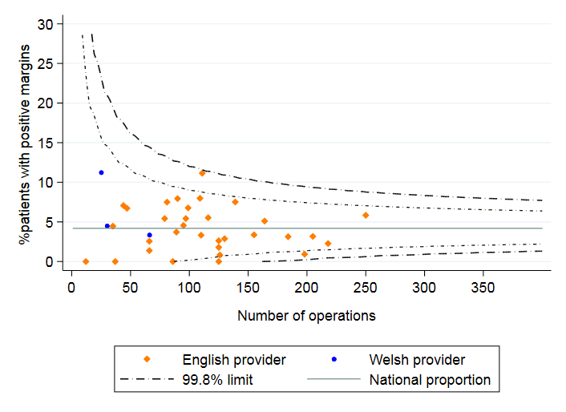
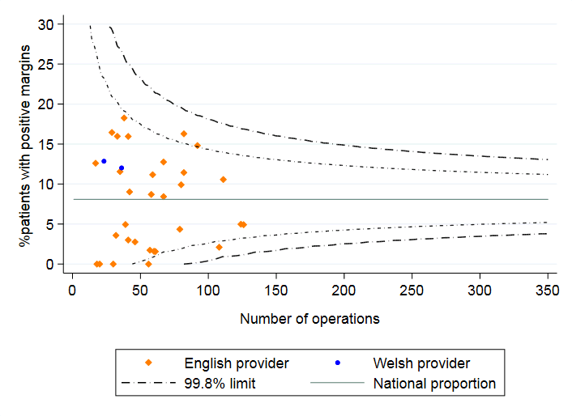
Adjusted rates of positive longitudinal margins
All NHS organisations achieved similar rates of positive longitudinal margins (risk-adjusted) after curative surgery, for patients diagnosed 2016-19
Oesophagectomy
Gastrectomy

Slide 31
Longer term outcomes after surgery
  For patients diagnosed between 2016-19, the 1-year survival after curative surgery was:
  82.7% among patients with oesophageal cancer and
  85.7% among patients with gastric cancer
Most surgical centres had an adjusted 1-year survival rate that fell within the expected range

Slide 32
Non-curative oncological treatment by tumour type
 | Oes SCC |  | Oes ACA Upper/Mid | Oes ACA Lower (w SI,SII) | Stomach (w SIII) | All
Chemotherapy | 405 (51%) |  | 215 (68%) | 1,321 (68%) | 803 (76%) | 2,744 (67%)
Radiotherapy | 344 (43%) |  | 94 (30%) | 593 (31%) | 245 (23%) | 1,276 (31%)
Chemo-radiotherapy | 41 (5%) |  | 7 (2%) | 24 (1%) | 12 (1%) | 84 (2%)
Immunotherapy | 1 (0.1%) |  | 0 | 1 (0.1%) | 1 (0.1%) | 3 (0.1%)
Outcome of chemotherapy
% Completed |  | 52.6% | 58.9% | 57.9% | 54.2% | 56.1%
Outcome of radiotherapy
% Completed |  | 97.2% | 93.2% | 97.9% | 96.6% | 97.1%

Slide 33
Non-curative oncological treatment
Recommendation | Pages
Work towards consensus-based practice in the use of triplet and doublet palliative chemotherapy regimens. | 47
 | Patients treated | Patients with outcome data | % Patients completing therapy
Chemotherapy | XX | XX | XX
Radiotherapy | XX | XX | XX
Results for your organisation are in Sheet 10 of the Data Tables

Slide 34
For further details: www.nogca.org.uk

